Slide 1
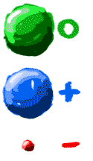
Subatomic Particles
Neutron
Neutral charge, large mass, located in nucleus
Proton
Positive charge, large mass, located in nucleus
Tells us the type of element (atomic number)
Electron
Negative change, tiny mass, located around nucleus
Electron configurations (1st shell, 2nd shell, etc)

Slide 2
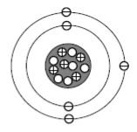
#1-5
The element represented by the diagram is BORON.

Slide 3
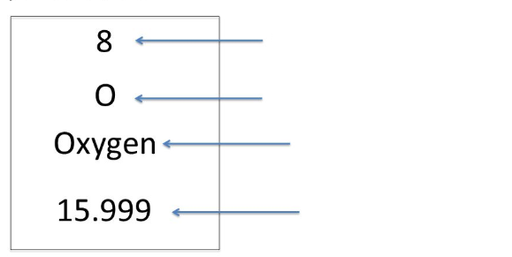
#6
Atomic Number
Symbol
Name
Atomic Mass

Slide 4
#7-10
The atomic number represents …
protons (or electrons if no charge)
The atomic mass represents …
protons and neutrons → electron mass too tiny
You can find the number of protons or electrons in an atom by …
Finding the atomic number
You can find the number of neutrons in an atom by …
Subtracting the atomic number from the atomic mass

Slide 5
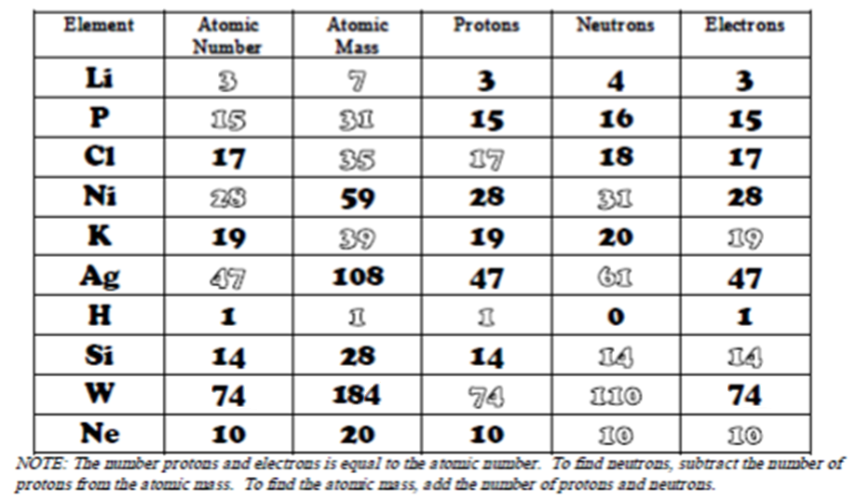
#11 – Use your knowledge to practice!

Slide 6
#12 Electron Configurations
Maximum number of electrons in each shell
1st: 2
2nd: 8
3rd: 18

Slide 7
#13 Electron Configurations
Electrons in the outermost shell or energy level are called VALENCE electrons
If outershell has only 1 valence electron, element is likely to lose an electron in a chemical bond
If outermost shell needs only 1 more valence electron to be full, element is likely to gain an electron in a chemical bond
If outermost shell is full, element is not likely to react with other elements

Slide 8
Watch Ms. Smith do #14 then complete #15-16 on your own.

