Slide 1
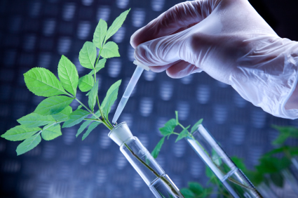
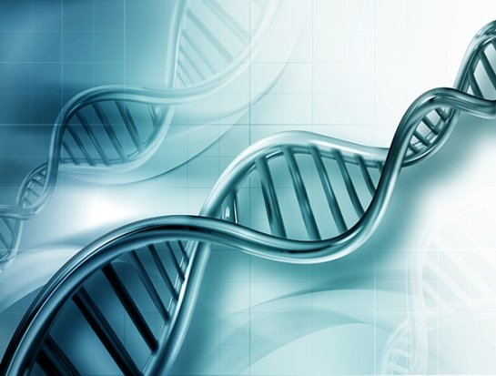
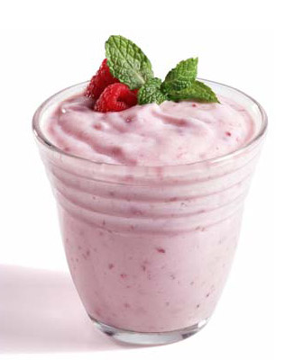
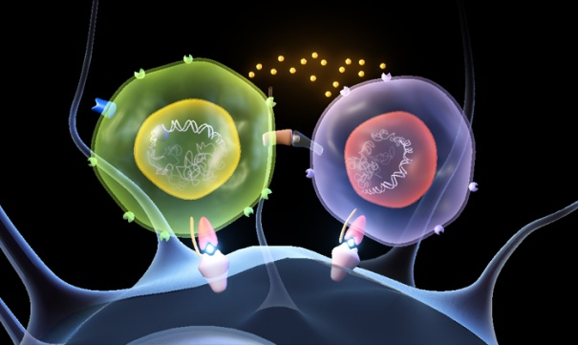
Biotechnology

Slide 2
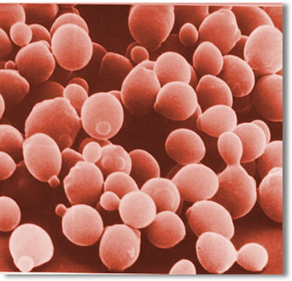
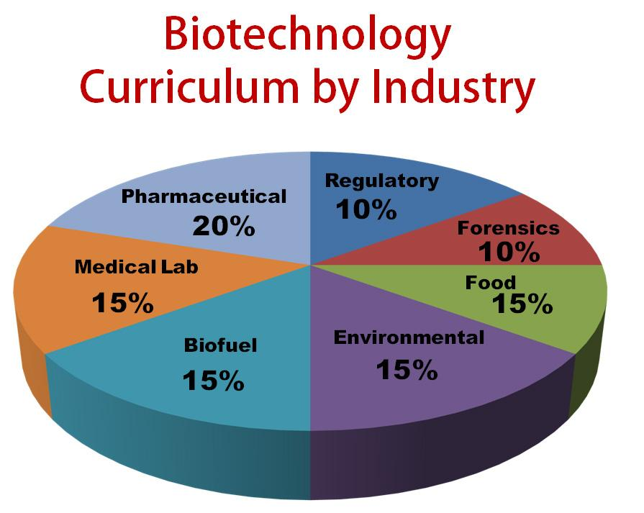
Biotechnology
The manipulation of biological processes or organisms to achieve a goal
Applications of Biotechnology:
Biofuels
Genetic Engineering
Bioremediation
GMO’s
Cloning

Slide 3
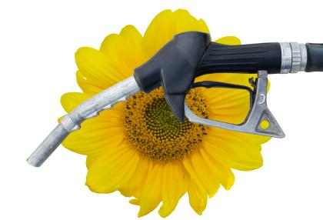
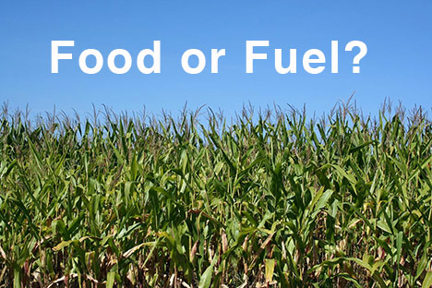
Biofuels
A type of energy derived from renewable plant and animal materials or organic matter.
Examples: Ethanol and Biodiesel

Slide 4
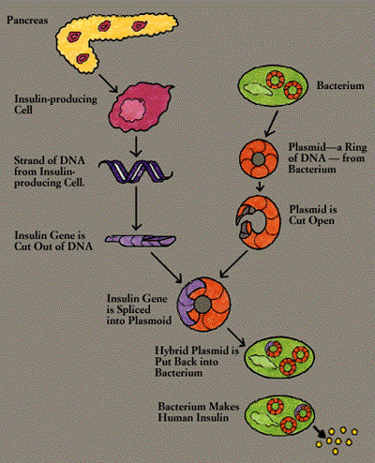
Genetic Engineering
DNA manipulation of cells or organisms
Genes are added, deleted or changed
Genetically Engineered Insulin
The gene for human insulin can
be inserted into bacteria.
Bacteria are able to produce
human insulin.

Slide 5
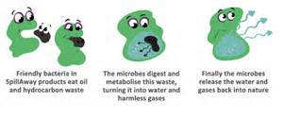
Bioremediation
Using microbes and other living things to clean up the environment
Example:
Genetically engineered Bacteria can be used to clean up an oil spill.

Slide 6
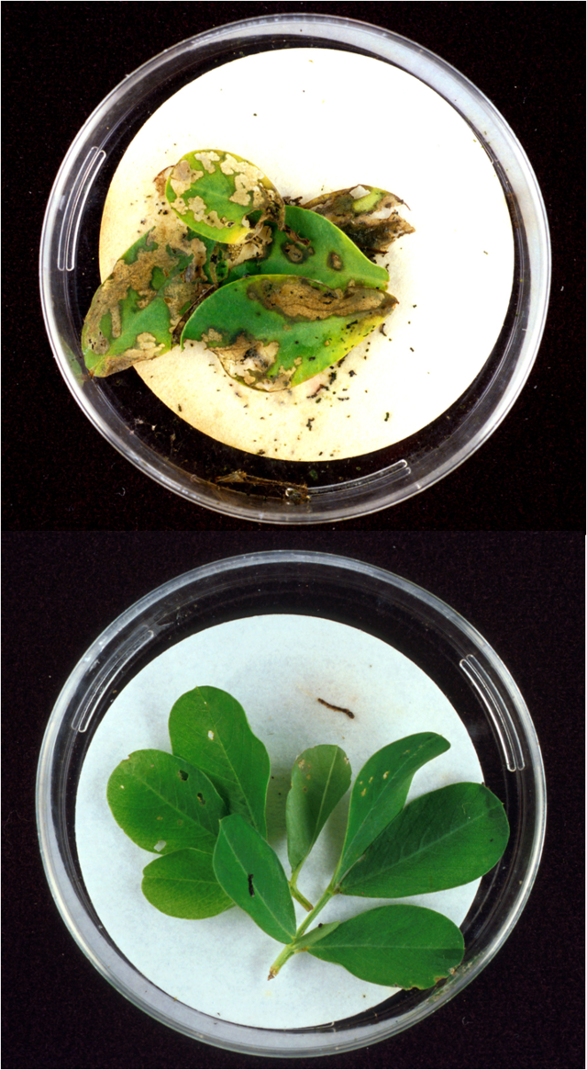
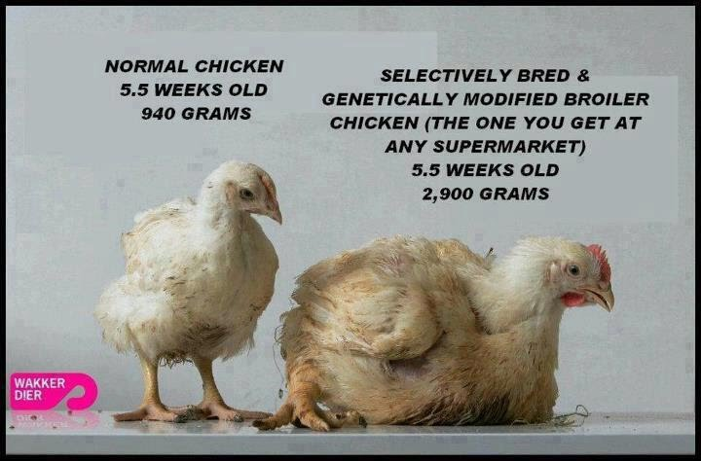
Genetically Modified Organisms
An organism that has been changed by genetic engineering
Also called “GMO’s”

Slide 7
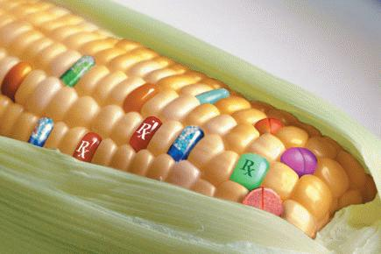
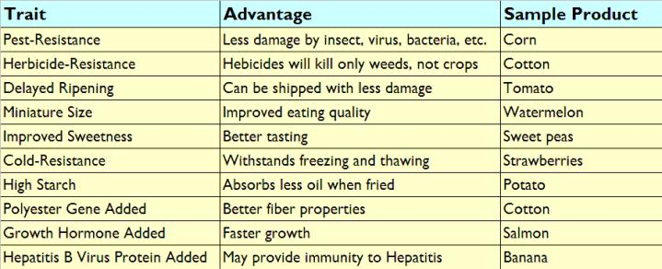
Genetically Modified Plants
The goal is to improve
crops and our food.

Slide 8
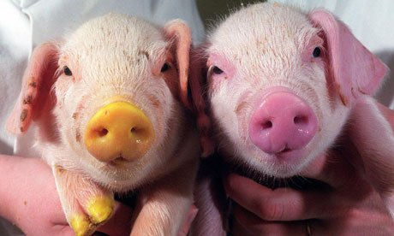
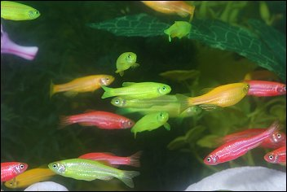
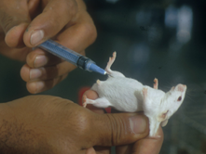
Genetically Modified Animals
Used to produce beneficial proteins, drugs, tissue for transplants
Examples:
Mice used to study medicine, cancer, etc.
Zebrafish made into “Glo-fish”

Slide 9
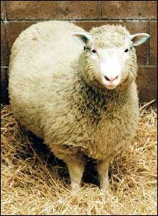
Cloning
Organisms that are genetically identical
Cloning began in 1952 with frogs
Dolly was the first animal cloned from adult cell

Slide 10
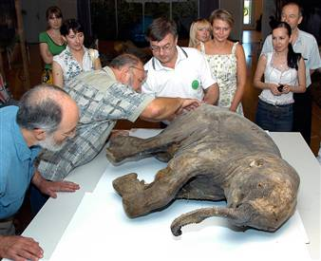
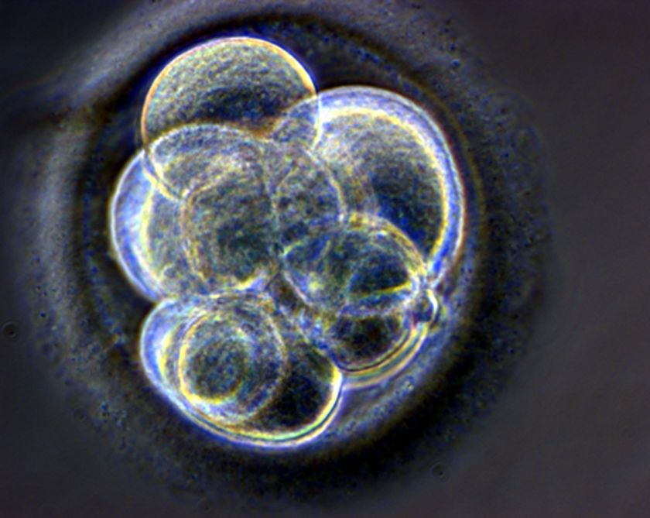
Biotechnology Ethics
Society’s responsibilities regarding uses of biotechnology

Slide 11
Biotechnology
Pros (Good) | Cons (Bad)
1. 2. 3. | 1. 2. 3.
Brainstorm with your partner about 3 ways that Biotechnology can be good and 3 ways it can be bad.

Slide 12
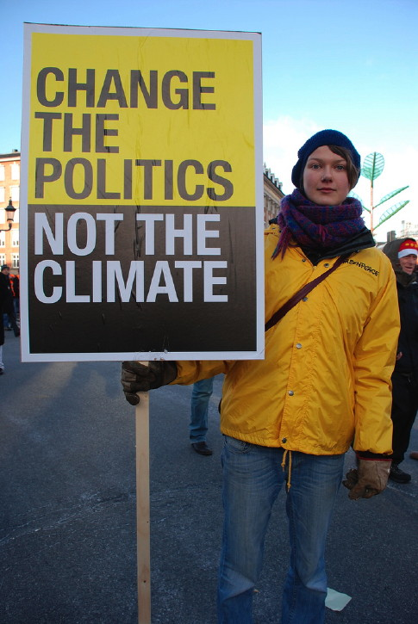
Biotechnology Protest Sign
Choose one application or use of Biotechnology (Example: Cloning)
Decide if you are FOR or AGAINST it.
Create a Protest Sign that clearly identifies:
What the application/use is
Whether you think it is good or bad
WHY you are for or against it
Use a catchy slogan if possible

