Slide 1
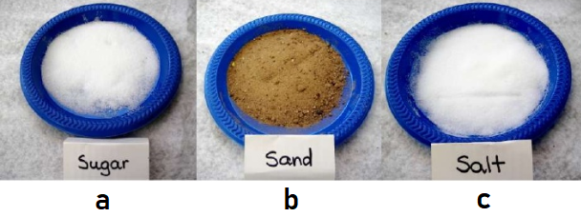
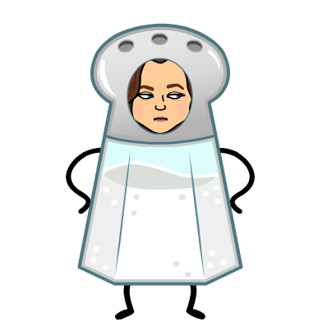
Please start a new BOP Sheet for this week.
Don’t forget to write your name and today’s date!
Which of the following samples dissolves in water?
Keep your BOP Sheet. We will turn it in on Friday.

Slide 2
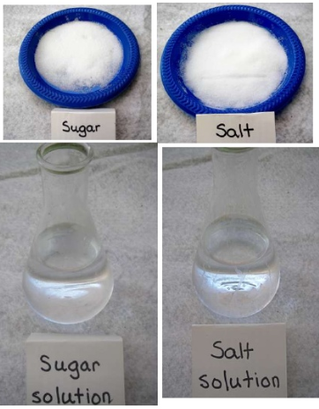
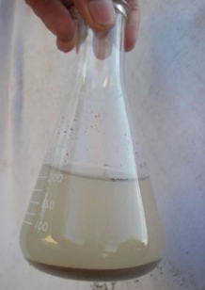
Yes, sugar and salt dissolve in water forming sugar and salt solutions
Sand does not dissolve in water

Slide 3
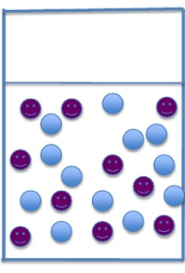
Sugar and salt break into molecules and mix evenly with the water molecules
You can no longer see the sugar or salt with your eyes. If the molecules are magnified, this is how sugar or salt molecules would look when dissolved in water

Slide 4
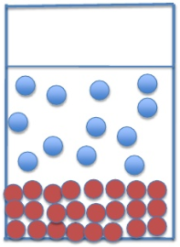
Sand molecules do not break apart or mix evenly with the water molecules
When you stop stirring the mixture, grains of sand sink to the bottom of the container
This is how the molecules of water and sand might look after the sand settles to the bottom of the container

