Slide 1
How Can We Change Matter Into New Substances?
Chemical reaction (or chemical change) is a change in a substance or substances that results in a totally new substance
Ex: 2H₂(g) + O₂(g) → 2H₂O(g)
Notice that the substances you start with (the reactants) combine to form a new substance (the product)

Slide 2
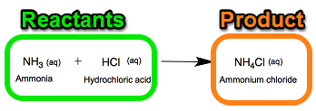

Slide 3
Examples of Chemical Reactions
Baking a cake: acidic milk and basic baking soda produce CO₂ gas
Burning paper: Produces ashes, CO₂, and H₂O vapor
Hydrogen peroxide decomposing: Produces water and oxygen gas

Slide 4
How Do I Know If A Chemical Reaction Has Occurred?
There are 5 indicators of a chemical reaction:
Evolution of a gas
Evolution of light
Evolution of heat
Color change
Evolution of a precipitate (insoluble substance)

Slide 5
*REMEMBER*
Chemical reactions occur to produce a more stable product than the existing reactants
Ex: 2Na(s) + Cl₂(g) → 2NaCl(s)
The products have totally different properties than the reactants
*The sodium and chlorine are both unstable
*The resulting sodium chloride is VERY stable

Slide 6
Where does the matter go?
When matter undergoes a chemical reaction (chemical change) it DOES NOT disappear
Atoms are rearranged and form new bonds…no matter is lost or gained!
This is called the Law of Conservation of Matter

Slide 7
