Slide 1
Infectious Diseases

Slide 2
What is an infectious disease?
Illness that passes from one organism to another caused by a pathogen
  A pathogen is an organism that causes disease

Slide 3
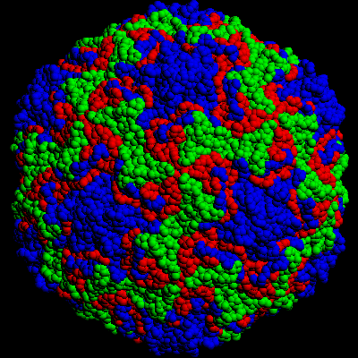
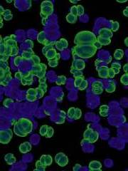

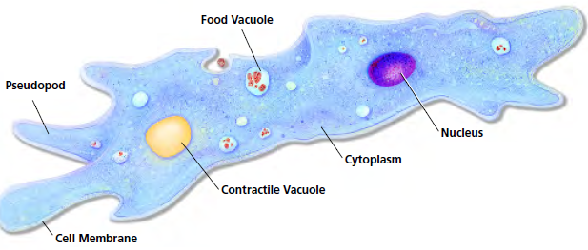
What are pathogens?
Can be:
  Bacteria
    Directly by damaging cells
    Indirectly by producing toxins (poisons)
  Viruses
  Fungi
  Protists

Slide 4
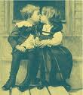
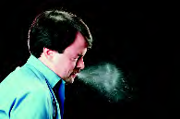
How are they spread?
Contact with infected person
  Directly by touching, hugging or kissing
  Indirectly by sneezing or coughing
  Flu or cold viruses

Slide 5
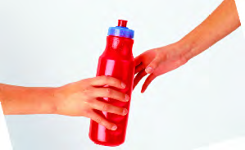
How are they spread?
Contact with contaminated object
  Eating/drinking after someone who is contaminated
  Touch contaminated object
  Flu and cold

Slide 6
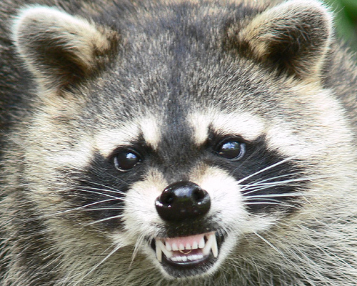
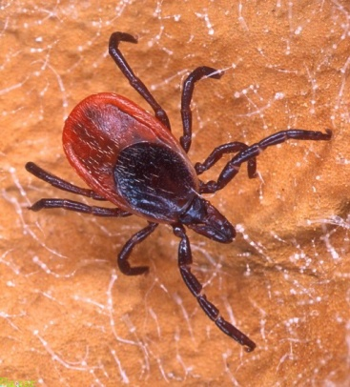
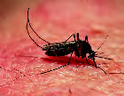
How are they spread?
Contact with infected animal or vector
  A vector is something that transmits the pathogen
    Raccoons -Rabies
    Ticks – Lyme disease
    Mosquito – West Nile virus

Slide 7
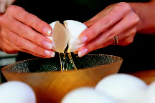
How are they spread?
Contact with environmental sources such as food, soil and water
  Poultry, eggs and meat – salmonella
  Soil – tetanus
    A toxin is a poison that is produced by a bacteria

Slide 8
Barriers that Keep Pathogens Out
First line of defense
  Skin – most pathogens get through the skin only when it is cut
  Breathing Passages – contain mucus and cilia that trap and remove most of the pathogens that enter the respiratory system
    May make you cough or sneeze
  Mouth and Stomach – saliva and stomach acid destroy most pathogens

Slide 9
The Inflammatory Response
Second Line Defense – the inflammatory response, fluid and white blood cells leak from blood vessels into nearby tissue and fight the pathogens
  White Blood Cells – the phagocyte is a white blood cell that engulfs and destroys pathogens
  Inflammation – the blood vessels widen allowing more white bloods cells to be delivered making the area red and swollen
  Fever – chemicals produced during inflammation cause a fever because some pathogens do not grow well at higher temperatures

Slide 10
The Immune System
The third line of defense – the immune system can distinguish between different kinds of pathogens with a defense targeted specifically at that pathogen
  lymphocytes are white blood cells that distinguish between different kinds of pathogens

Slide 11
The Immune System
T Cells – major function of T cells is to identify pathogens and distinguish one kind of pathogen from another
  They recognize markers or antigens (molecules that the identify each pathogen)
  Each antigen has a different chemical structure

Slide 12
The Immune System
B Cells – lymphocytes the produce proteins that help destroy pathogens called antibodies
  Each B cell produces only one kind of antibody, each with a different structure
    They mark the pathogen for destruction
      Making them clump together
      Keep from attaching to cells
      Make them easier for phagocytes to destroy

Slide 14
HIV
Only known virus to attack the human immune system directly and destroying T cells causing the body to lose its ability to fight disease
Spread from one person to another only if bodily fluids from an infected person come in contact with those of an uninfected person
You CANNOT get it from contact such as hugging or shaking hands

Slide 15
Active Immunity
A person acquires active immunity when their own immune system produces antibodies in response to the presence of a pathogen
  Can result from either getting the disease or being vaccinated

Slide 16
The Immune Response
When someone gets a disease active immunity is produced and once the person recovers, some T cells and B cells “remember” the pathogen’s antigen
Once that pathogen enters the body again, these memory cells recognize the antigen and start the immune response so quickly the person usually does not get sick.

Slide 17
Vaccination
Vaccination or immunization is the process by which harmless antigens are deliberately introduced into a person’s body to produce active immunity
The substance used in a vaccination is called a vaccine which consists of a pathogen that has been weakened or killed but can still trigger the immune system

Slide 18

Getting Sick
If you do become sick, sometimes medications can help
  If it is caused by a bacteria you may be given an antibiotic – a chemical the kills or slows the growth of bacteria without harming the body cells

Slide 19
Caution!!!
Antibiotic Resistance
  Bacteria that have survived in the presence of an antibiotic have become resistant making it more difficult to treat.

Slide 20
How are they treated?
There are currently no medications that can cure viral infections.
  Medications can help relieve the symptoms
  Best treatment – rest, liquids and healthy diet

Slide 21
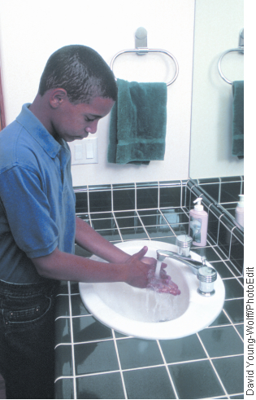
How can they be prevented?
Vaccines may be used
Keep your body healthy
  Eat and sleep right
  Wash your hands often
  Do not share eating or drinking
Store and cook food properly

Slide 22
Passive Immunity
Passive immunity results when antibodies are given to a person – the person’s immune system does not make them.
  A baby acquires passive immunity to some diseases before birth

Slide 23
Noninfectious Disease
Noninfectious diseases are diseases that are not caused by pathogens, they cannot be transmitted from one person to another
  Examples:
    Cardiovascular disease
    Allergies
    Diabetes
    cancer

