Slide 1
**REMEMBER** . An atom is the smallest unit of matter. → Protons (+), Neutrons (o), and Electrons (-) . An element is a pure substance that is made entirely from one type of atom. . The atomic number is ALWAYS the number of protons in the nucleus of an atom.

Slide 2
Ions
Ions are atoms or molecules with an electric charge.
The electric charge is caused by either the LOSS or GAIN of electron(s).

Slide 3
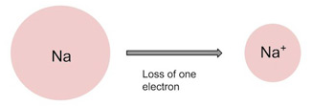
Remember to write + or – to indicate charge.
If an atom LOSES electrons, there will be more protons (+).
There’s a positive charge. This is called a cation.
If an atom GAINS electrons, there will be more electrons (-).
There’s a negative charge. This is called an anion.

Slide 4
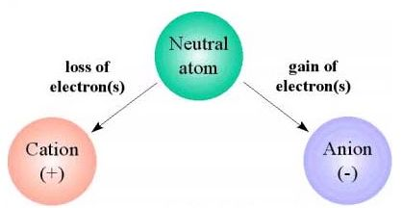

Slide 5
Isotopes
Isotopes are atoms of the same type, but they have a different number of neutrons.
The atomic mass is the average mass of all the isotopes of an element.
Carbon containing 6 protons and 6 neutrons: atomic mass = 12
Carbon containing 6 protons and 7 neutrons: atomic mass = 13
Carbon containing 6 protons and 8 neutrons: atomic mass = 14

Slide 6
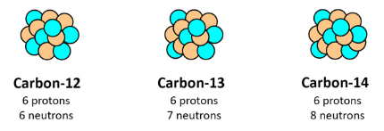
For isotopes, remember to write the mass number beside the element name.

Slide 7
Helpful formulas:
Atomic number = # protons
Atomic mass = # protons + # neutrons
Charge = # protons - # electrons
If no charge, then # protons = # electrons

Slide 8
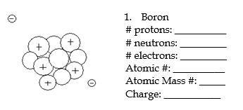
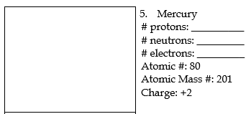
Watch Ms. Smith do #1 & #5, then complete the rest of “Practice with Atomic Structure” on your own.

