Slide 1
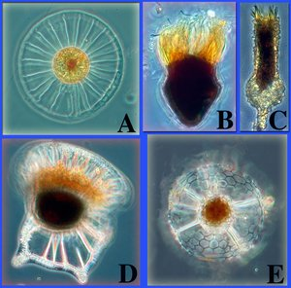
MICROBES
Are they all pathogens?

Slide 2
Viruses
Characteristics:
NOT cells;
do not use own energy to grow;
can’t make own food
or produce wastes;
are able to multiply in host cell

Slide 3
Viruses
Host
Parasite
organism that is source
of energy for virus
virus causes harm to host cell—almost all viruses destroy the cell

Slide 4
Viruses
Shapes:
Size:
bacteriophage- virus in
bacteria cell—robot-like shape
Other types—round,
Bricklike, threads or bullet
200 nanometers to 20 nanometers

Slide 5
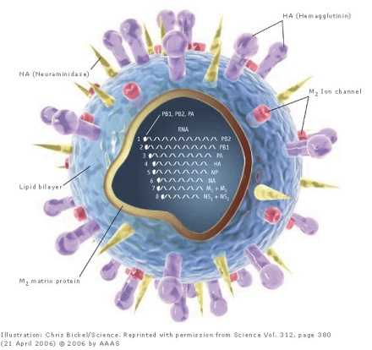
Viruses
Named:
Structure:
for scientists, places found, or disease they cause
Protein coat-lock to fit certain host
Inner core-genetic material

Slide 6
Virus
Reproduce
Active Virus
Hidden Virus
must be inside host cell to produce a new virus
immediately attack and take over cell. Ex. Cold virus
Enter & hide temporarily
Ex. HIV virus & cold sore virus

Slide 7
Impact of Viruses
Negative→DISEASE:
Shorterm Colds & Flu
Longterm Rabies, distemper, HIV
Positive→ Gene Therapy:
Virus acts as messenger to redirect cell for medical treatment. Ex. Cystic fibrous

Slide 8
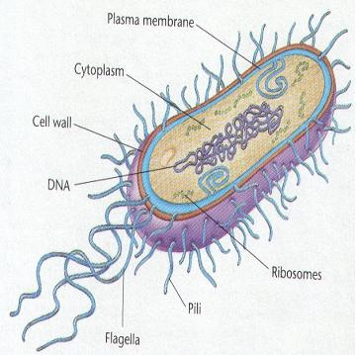
Bacteria
Bacteria Cell Structure:
single cell;prokaroyotes (no nucleus)
Cell wall & membrane; cytoplasm & ribosomes
Genetic material in cytoplasm like a tangled string

Slide 9
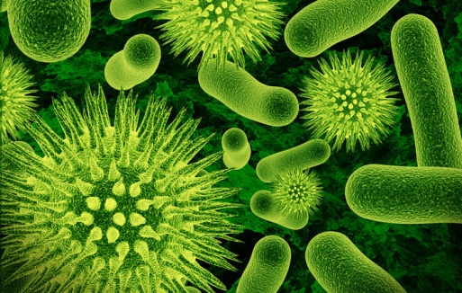
Bacteria
Movement:
Shape:
flagellum (whiplike tail) OR air currents OR water currents
Spherical, rod, or spiral

Slide 10
Bacteria
Size:
Food:
0 to ½ micrometer
some are autotrophs so photosynthesis or chemical synthesis for food
Some are heterotrophs so consume food like decaying leaves, . . .

Slide 11
Bacteria
Energy Source:
Reproduce:
respiration—most use oxygen but some are anaerobic
Can reproduce as often as every 20 minutes;
Asexual by binary fission --cell copies & splits into 2 cells.
Sexual- 2 parent bacteria combine genetic material thru a threadlike bridge to produce a daughter cell. Called Conjugation.

Slide 12
Bacteria
Reproduction continued:
Form endospores-when trying to survive harsh conditions. It forms a spore within the bacteria cell.
It contains genetic material and cytoplasm and can survive for many years.
Then can be released and carried to a new place.
Ex. Clostidium botulinum –when conditions become favorable, they open up and begin to multiply

Slide 13
Bacteria:
Role of Bacteria:
Pasteurization:
Positive: oxygen production; recycling and clean up of decaying matter; food production—pickles, vinegar; medicine such as insulin; body processes such as digestion
Negative: spoiling food, disease such as strep throat
method to kill bacteria in foods such as milk products; uses high heat and does not alter taste of food

Slide 14
Infectious Disease:
What is an infectious disease?
How are they spread?
Illness that passes from one organism to another
Inhaled, swallowed or ingested, enter through moist body cavities—ie. nose

Slide 15
Infectious Disease:
Bacteria infections are treated with:
Viral ailments are treated:
Antibiotics which are chemicals that can kill only the bacteria
Over the counter medications can relieve symptoms of most viral infections such as cold or flu
Some antiviral drugs are prescription such as ones for HIV

Slide 16
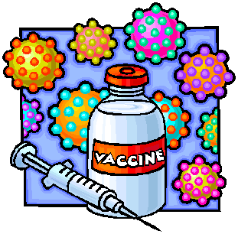
Infectious Disease:
How prevented?
Antibiotic Resistance is:
Vaccines are introduced to the body to stimulate the production of chemicals to destroy the virus or bacteria.
When bacteria adapt to resist the chemical affects of the antibiotic so the bacteria survives the antibiotic

Slide 17
Protists/Parasites:
Eukaroytes that CANNOT be classified in the animal, plant, or fungi kingdoms. Known as “odds & ends” kingdom. All live in moist surroundings. Can be uni or multicellular; may be auto or hetrotrophs; some move and some are stationary.

Slide 18
Unicellular – composed of only one cell.
Multicellular – composed of more than one cell.
Eukaryote: an organism that contains membrane-bound organelles and genetic material within a nucleus.
Prokaryote: a unicellular organism that lacks a true nucleus and membrane-bound organelle.

Slide 19
Protozoans that are Parasites
Parasites are things that must have a host to survive.
Move in a wide variety of ways but must have a host to feed on.
Plasmodium is a protozoa that causes Malaria and has multiple hosts.
Usually spread by a mosquito biting an infected person then biting a healthy person

Slide 20
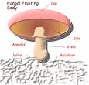
What is a fungi?
Fungi are:
Cell Structure:
Eukaryotes that have cell walls and are hetrotrophs.
Arranged in structures called hyphae. These are branching, threadlike tubes that make up the bodies of multicellular fungi
Cap
Gills
Stalk
hyphae

Slide 21
Fungi:
Food:
Reproduce:
Absorb food through the hyphae that grow on food source
Lightweight spores are surrounded by a protective coating & can be carried easily through water or air to a new site. Spores reproduce in fruiting bodies.
Most reproduce sexually & asexually.

Slide 22
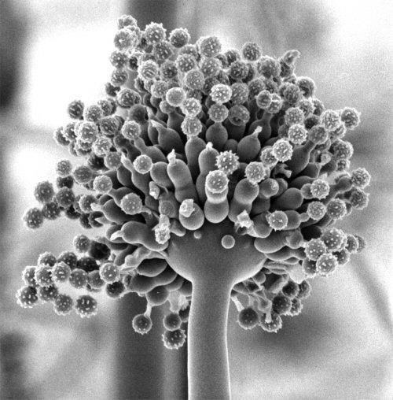
Fungi
Reproduce continued:
Cells at the tip of the hyphae divide to form spores—grow into fungi that are identical to parent. Unicellular yeast undergoes budding (asexual). There are no spores. Yeast buds and breaks away from parent.
When 2 hyphae from 2 fungi grow together genetic material is exchanged. Spores are different from either parent. (sexual)

Slide 23
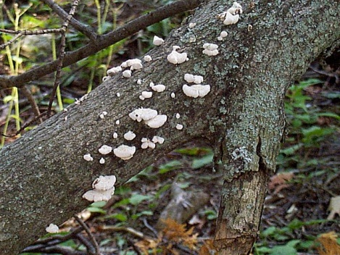
Fungi:
Classification:
Role in Nature:
Grouped according to reproduction—sac fungi, club fungi, or zygote fungi
+ decomposers in nature-break down the chemicals in dead organisms
Food- yeast in bread; mold to blue cheese
Medicine- penicillin
Lichens-fungi + algae in community

Slide 24
Fungi:
Role in nature:
– sensitive to air pollution & indicate health of an area
Plant roots grow into Hyphae underground spread out and absorb water & nutrients from soil, help plant grow better

