Slide 1
Population Dynamics Notes

Slide 2
Ecosystem Levels of Organization (Hierarchy)
Organism: a single member of a species
Population: all the organisms of one species that live in the
same place at the same time. They can be described
based on their size, distribution or density.
Community: all the different populations that live in an
area at the same time. This includes plants,
animals, bacteria, etc. All BIOTIC FACTORS

Slide 3
Ecosystem Levels of Organization (Hierarchy)
A system formed by the interaction of a
community of organisms with their environment.
This includes biotic and abiotic factors in the environment.

Slide 4
Within an ecosystem, each species has a…
Habitat: the place where an organism lives. It supplies all the biotic and abiotic factors the organism needs to survive.
Niche: an organism’s role/”job.”
what it eats, how it eats and what it eats…
If the niche of one organism overlaps the niche of another organism, you have competition!

Slide 5
Population Dynamics
http://www.bbc.com/future/story/20140128-how-wolves-saved-a-famous-park
Why do populations look like this
Instead of this?

Slide 6
Why can’t we have 1,000,000 students at our school?
Space
Teachers
Supplies
Student behavior
These
resources are
limiting factors

Slide 8
2 Types of Limiting Factors:
Density Dependent
These increase their affect on a population as the population density increases
They are a type of negative feedback that help to stabilize a population
These are usually biotic
Density Independent
These affect a population regardless of its density/size
They do not act as feedback to slow growth or stabilize a population.
These are usually abiotic
Try and sort your list into these two categories

Slide 9
Density Dependent Density Independent
Food Weather
Predators Natural Disasters
Disease

Slide 10
Carrying Capacity
An environment can only support as many organisms as there is available food, shelter, water and space.
Carrying capacity = maximum number of organisms that can live in an ecosystem
Limiting factors determine carrying capacity.

Slide 11
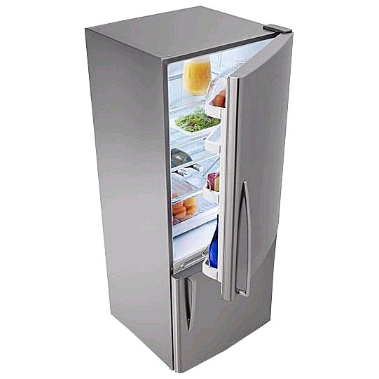
Imagine Your Fridge
Your fridge is like all of the resources (food, water, shelter, space) in an ecosystem.
What if we want to throw a party?
Notes:
There’s only so much food in there, and it will only last so long until you re-fill it.
Of course, we can’t just re-fill it all the time. Some of us have to wait until that next paycheck before we can buy groceries.

Slide 12
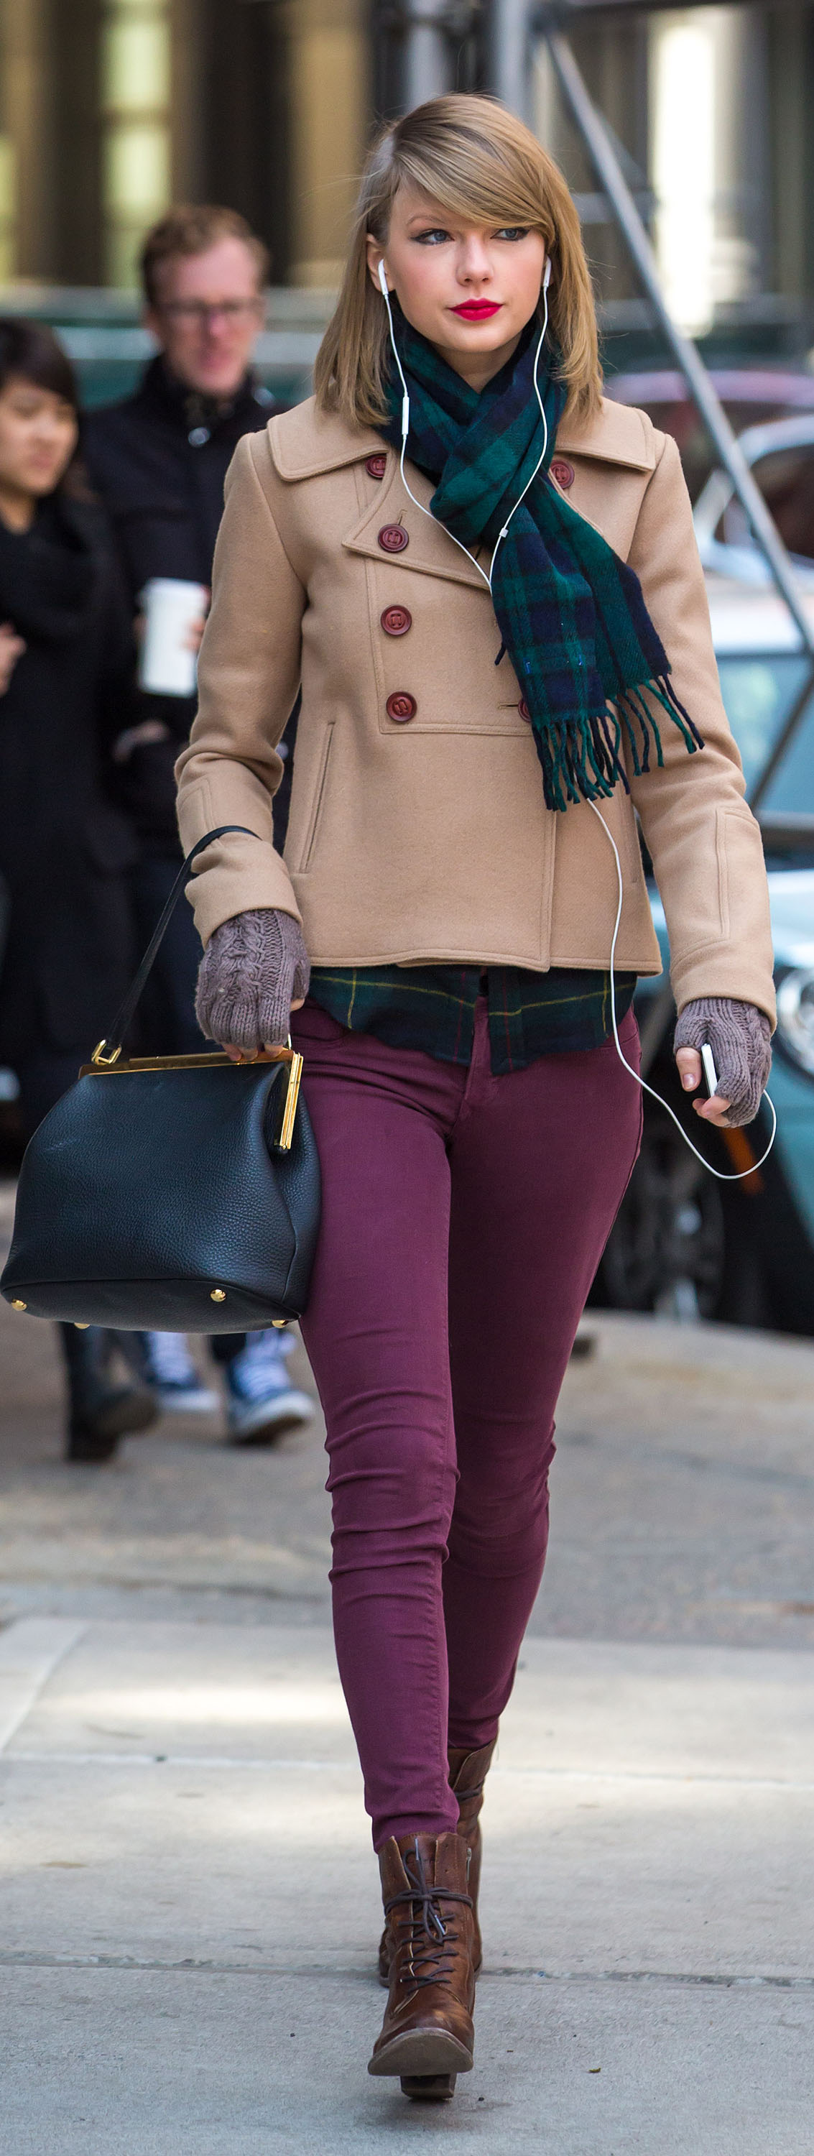
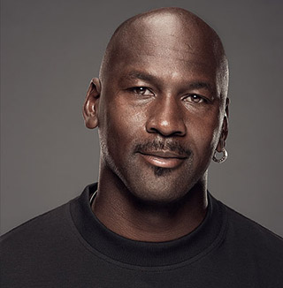
Imagine Your Fridge
We can keep inviting people, as long as there’s enough food in the fridge.
But with each new guest, there’s less to go around.
Notes:
Each friend eats a different amount of food, just like each species has a different carrying capacity

Slide 13
Imagine Your Fridge
The fridge won’t replenish magically, and I don’t have the money to keep putting food in the fridge forever.
So too many guests means that…
So too many animals means that…
Someone goes hungry…
Not enough food/water/free space…
And leaves the party. ☹
And organisms die. ☹

Slide 14
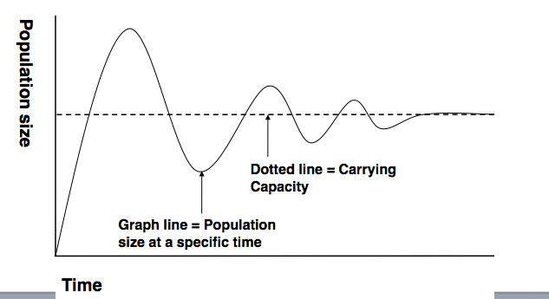
Carrying Capacity
When a population is BELOW its carrying capacity, it will INCREASE in size
Birth rate exceeds death rates
When a population is ABOVE its carrying capacity, it will DECREASE in size
Birth rate exceeds death rates
Until eventually, the population size BECOMES STABLE AT THE CARRYING CAPACITY
Birth rate = death rate
Carrying Capacity Video: https://www.youtube.com/watch?v=QI2ixJeIxEU
Notes:
A = x-axis = time
C = y-axis = population size
B = graph shows population size at any given time
D = carrying capacity

