Slide 1
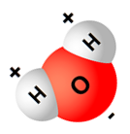
Water
Buoyancy
Adhesion
H₂O
Capillary Action
Cohesion
Specific
Heat
Polarity
The “Universal Solvent”
Solubility
Surface Tension

