Slide 1
Why is safety important in a laboratory setting?

Slide 2
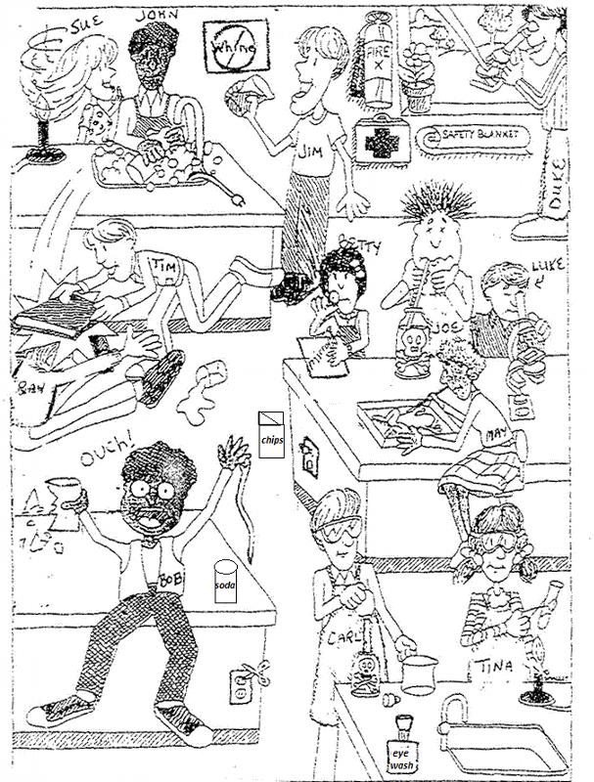
What is wrong with
this picture?

Slide 3
Safety Contract
This MUST be signed in order to participate in any labs in the classroom.

Slide 4
Safety Quiz TOMORROW...let’s review.
1. Approved eye protection devices
(such as goggles) are worn in the lab
A. to avoid eye strain.
B. to improve your vision.
C. only if you don’t have corrective
glasses.
D. any time chemicals, heat or
glassware are used.

Slide 5
Safety Quiz TOMORROW...let’s review.
2. If you don’t understand a direction
or part of a lab procedure, you should
A. figure it out as you do the lab.
B. try several methods until
something works.
C. ask the instructor before continuing.
D. skip it and go on to the next part.

Slide 6
Safety Quiz TOMORROW...let’s review.
3. After completing an experiment, all wastes
should be
A. left at your lab station for the next class
B. disposed of according to your teacher’s
directions.
C. dumped in the sink.
D. taken home.

Slide 7
Safety Quiz TOMORROW...let’s review.
4. You have been injured in the lab (cut, burn, etc.).
First you should
A. visit the school nurse after class.
B. see a doctor after school.
C. tell the science teacher at once.
D. apply first aid yourself.

Slide 8
Safety Quiz TOMORROW...let’s review.
5. When gathering glassware and equipment
for an experiment, you should
A. read all directions carefully to know what
equipment is necessary.
B. examine all glassware to check for chips
or cracks.
C. clean any glassware that appears dirty.
D. all of the above.

Slide 9
Safety Quiz TOMORROW...let’s review.
6. Long hair in the lab must be
A. cut short.
B. held away from the experiment with
one hand.
C. always neatly groomed.
D. tied back or kept entirely out of the way
with a hair band or hairpins.

Slide 10
Safety Quiz TOMORROW...let’s review.
7. In a lab, the following should NOT be worn.
A. loose clothing.
B. dangling jewelry.
C. sandals.
D. all of the above.

Slide 11
Safety Quiz TOMORROW...let’s review.
8. The following footwear is best in the lab.
A. sandals.
B. open-toed shoes.
C. closed-toed shoes.
D. shoes appropriate for the weather.

Slide 12
Safety Quiz TOMORROW...let’s review.
9. Horseplay or practical jokes in the lab are
A. always against the rules.
B. okay.
C. not dangerous.
D. okay if you are working alone.

Slide 13
Safety Quiz TOMORROW...let’s review.
10. If a piece of equipment is not working
properly, stop, turn it off, and tell
A. the custodian.
B. your lab partner.
C. your best friend in the class.
D. the science teacher.

