Slide 1
Scientific Method

Slide 2
What is the scientific method?
It is a process that is used to find answers to questions about the world around us.

Slide 3
Is there only one “scientific method”?
No!

Slide 4
There are several versions of the scientific method. Some versions have more steps, while others may have only a few. However, they all begin with the identification of a problem or a question to be answered based on observations of the world around us and provide an organized method for conducting and analyzing an experiment.

Slide 5
What is a hypothesis?
It is an educated guess based on observations and your knowledge of the topic.

Slide 6
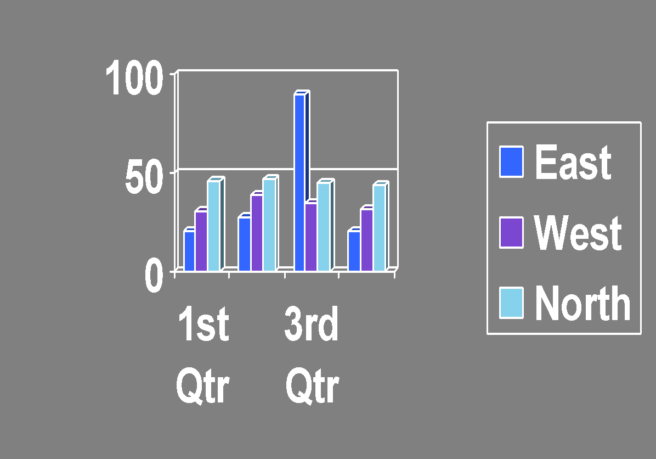
What is data?
It is information gathered during an experiment.

Slide 7
What are the steps of the Scientific Method?

Slide 8
Identify the problem
What do you want to know or explain?
Use observations you have made to write a question that addresses the problem or topic you want to investigate.

Slide 9
Form Hypothesis
What do you think will happen?
Predict the answer to your question or the outcome of the experiment.

Slide 10
Create an Experiment
How will you test your hypothesis?
Develop a procedure for a reliable experiment and address safety rules.

Slide 11
Perform an Experiment
Follow the steps in your procedure to perform your experiment.
Record data and observations.

Slide 12
Analyze the Data
Is the data reliable?
Does your data and observations from the experiment support your hypothesis?

Slide 13
YES!!!! Then Communicate the Results
Write a conclusion that summarizes the important parts of your experiment and the results.

Slide 14
If your data is not supportive- is your data inaccurate or the experiment flawed?
If data is incorrect: MODIFY the Experiment.
Rewrite your procedure to address the flaws in the original experiment
If the data is correct and the experiment is not flawed: Communicate the Results.
Write a conclusion that summarizes the important parts of your experiment and the results.

