Slide 1
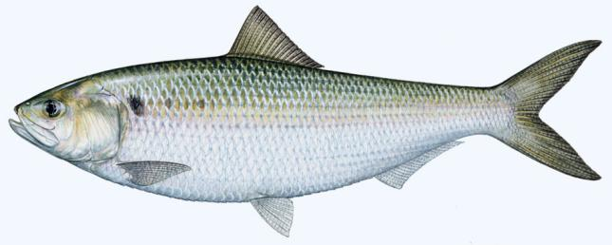
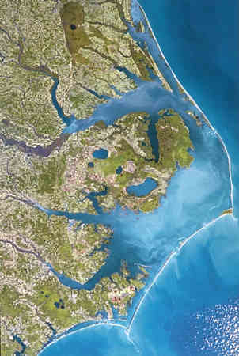
LIFE HISTORY OF AMERICAN SHAD
Joe Hightower
U. S. Geological Survey
North Carolina State University
Shad in the Classroom Workshop – 22 February 2014

Slide 2
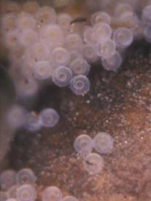
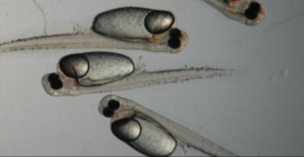
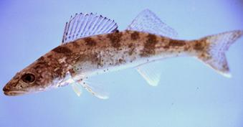
LIFE HISTORY
Life history: phases of life cycle, with particular reference to strategies influencing survival and reproduction
egg – larvae (yolk) – fry – juvenile – adult
Walleye (Sander vitreus)

Slide 3
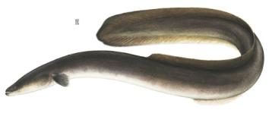
Diadromous: Distinct life stages in both freshwater & saltwater
Anadromous:
Spawn in freshwater, grow and mature in saltwater
Salmon Herring Striped Bass Sturgeon
Catadromous:
Spawn in saltwater, grow and mature in freshwater
American eel

Slide 4
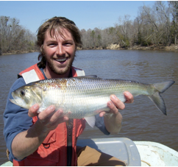
AMERICAN SHAD
Alosa sapidissima
Family: Clupeidae (herring, shads, sardines, menhaden)
Genus: Alosa (hickory shad, A. shad, blueback herring, alewife)
Species: sapidissima = most delicious
Common name: white shad

Slide 5
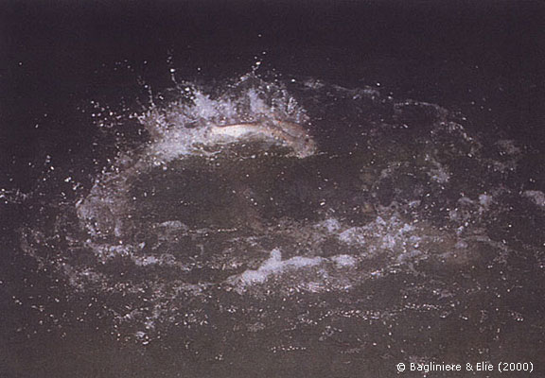
SPAWNING
Where: Most major Atlantic coast rivers and tributaries
When: Depends on latitude (water temperature)
Dec-Feb (South), Mar-May (Mid), May-Jul (North)
Highest activity in evening, early night
Who: Group of males with one or more females
How: Group rises to surface, shaking releases eggs & milt
Broadcast spawn, no parental care (no nests)
Often spawn over rock substrates, moderate river flows
http://www.lanuv.nrw.de/alosa-alosa/en/maifisch/lebenszyklus/index.html

Slide 6
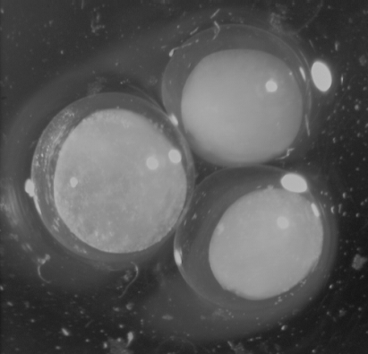
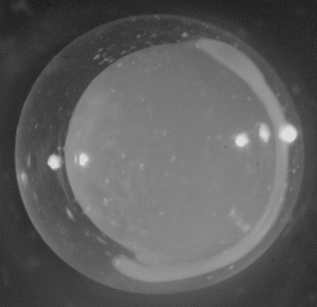
EGGS
Females deposit 100,000 – 600,000 eggs
“Batch spawners”:
Various developmental stages
Spawn multiple times
Eggs are 2 – 3 mm (~ 0.1 in) in diameter
Eggs are usually transparent
Eggs settle into substrates or drift
Eggs hatch in a few days to two weeks

Slide 7
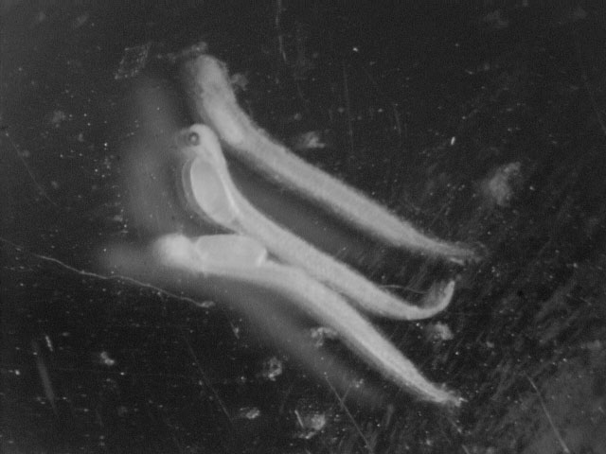
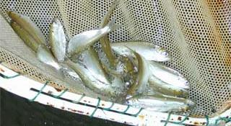
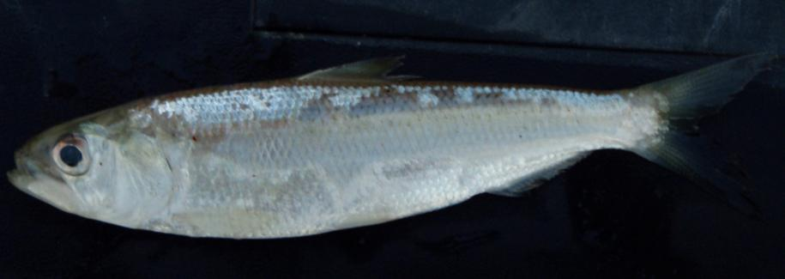
YOUNG
Hatching larvae are around 9 - 10 mm (~0.4 in)
Fry / juveniles feed on invertebrates (plankton, benthos)
3 – 4.5 in when they leave rivers in fall and migrate to ocean

Slide 8
ADULTS
In ocean, feed on plankton (filter feeders, gill rakers)
In freshwater, consume very little, if anything
Mature: males ~ 3-5 years, females ~ 4-6 years
Size: Males ~ 1 – 3 pounds, ~ 16 - 20 inches
Females ~ 3 – 8 pounds, 18 – 24 inches
Life span: 3 to maximum of ~10 years
Southern populations die after spawning
Northern populations spawn multiple times
North Carolina believe to be a transition zone

Slide 9
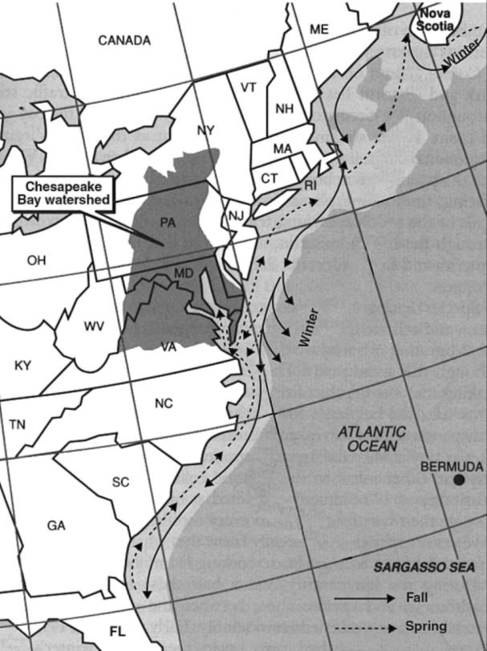
MIGRATIONS
Winter-early summer (spawning):
Homing (return) to natal river
Olfaction, rheotaxis (movement in response to current)
Summer-fall (post-spawning):
All populations - Bay of Fundy
Winter:
Offshore, deeper water
Body shape: fusiform (streamlined)

Slide 10
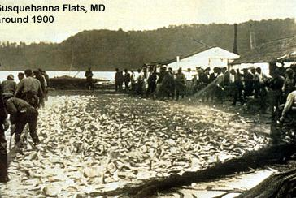
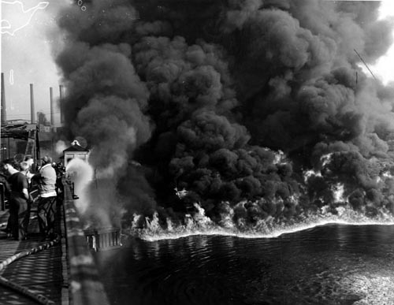
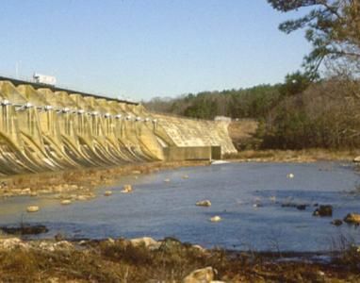
POPULATION DECLINES
Dramatic declines in shad landings
Late 1800’s, early 1900’s
WHY?
Overfishing
Habitat degradation (pollution)
Habitat loss (dams)

Slide 11
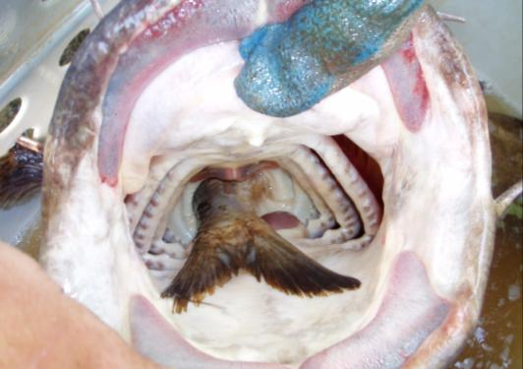
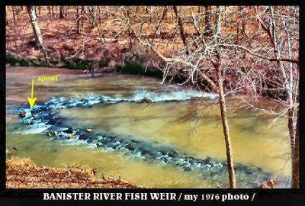
SHAD IMPORTANCE
Ecological importance:
Predators and prey in ocean
Huge influx of nutrients into freshwater
Historical importance:
Native Americans used rock fish weirs
Saved George Washington’s troops
from starvation in Revolutionary War
http://www.pittpaths.com/st/0160.htm

Slide 12
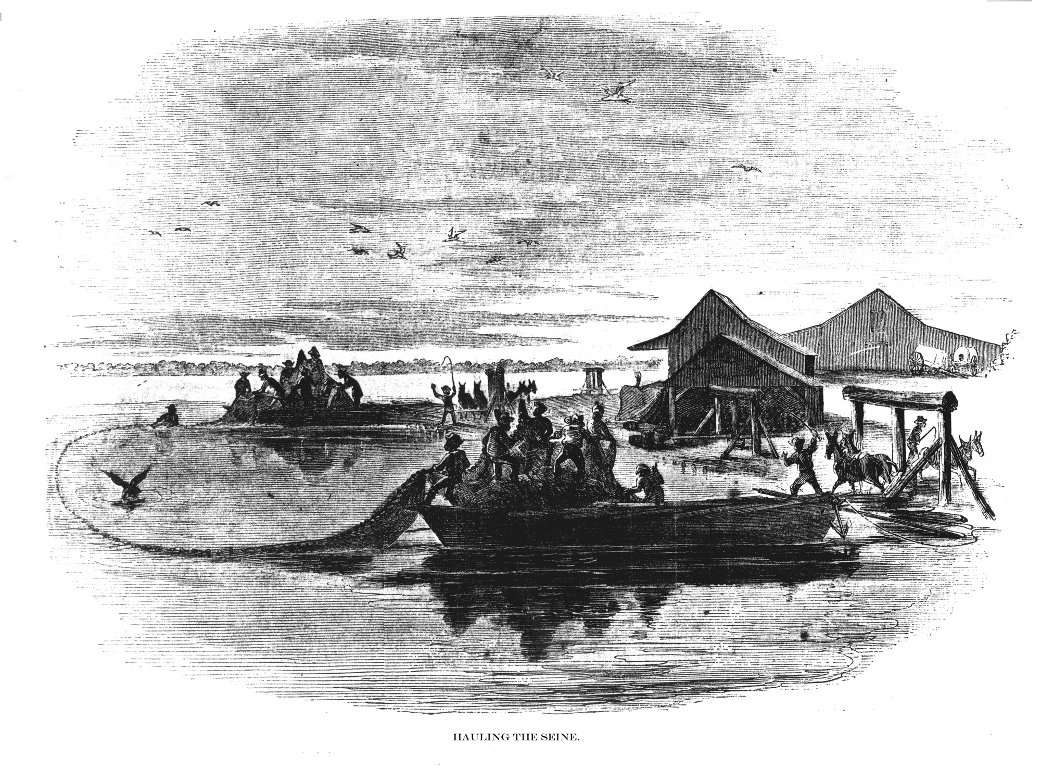
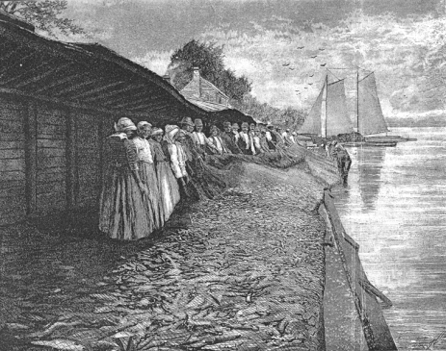
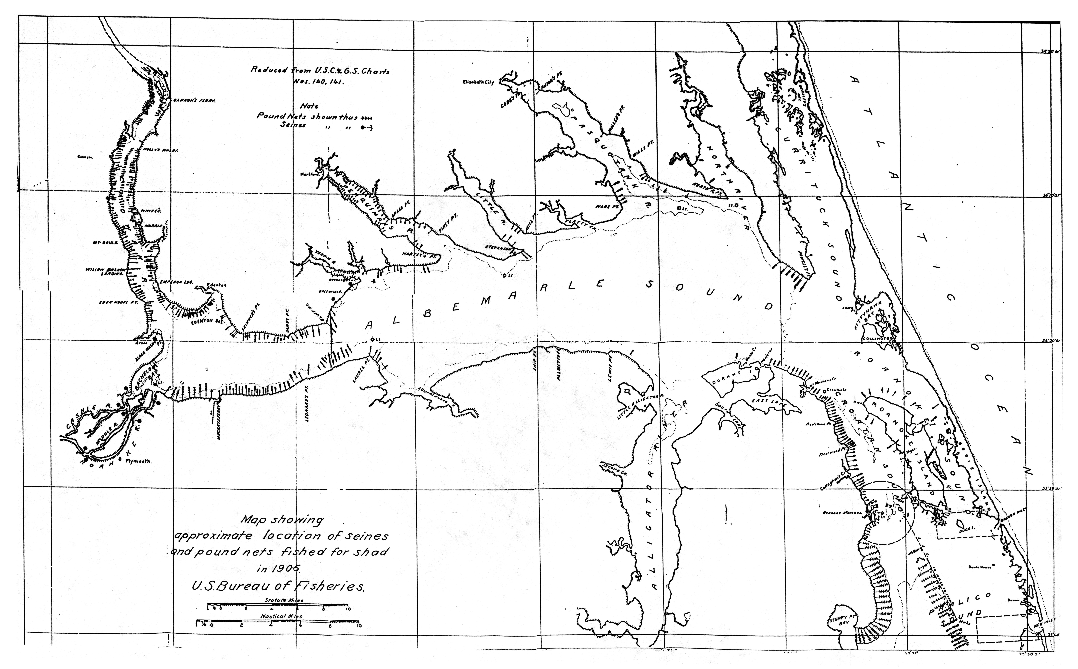
SHAD IMPORTANCE
Economic importance:
Commercial fisheries (historical)
Recreational fisheries (emerging)

Slide 13
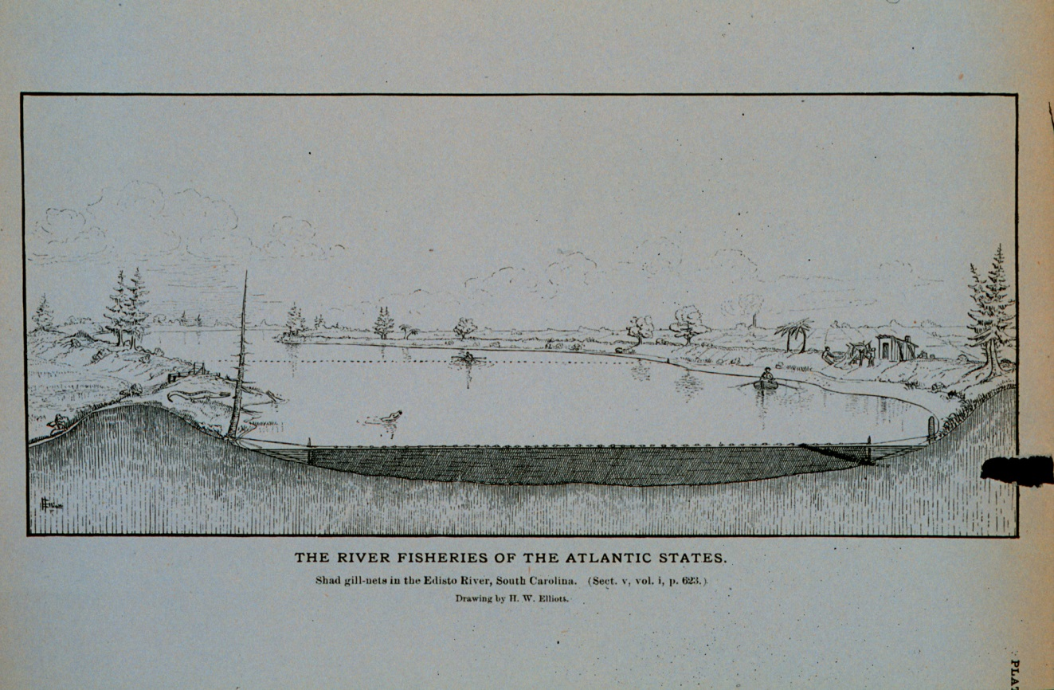
SHAD IMPORTANCE
Economic importance:
Commercial fisheries (historical)
Recreational fisheries (emerging)

Slide 14
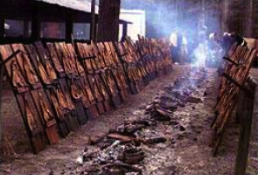
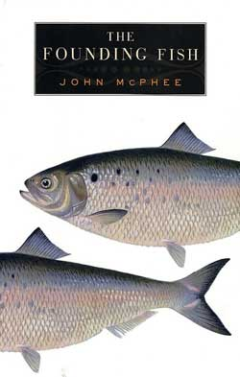
SHAD IMPORTANCE
Cultural importance:
Shad bakes / plankings / festivals
Other:
John McPhee, The Founding Fish
Often used in habitat studies related to dams

Slide 15
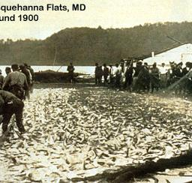
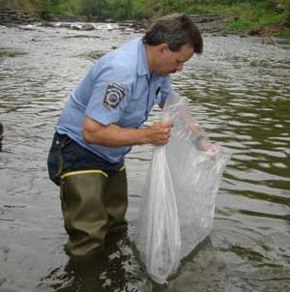
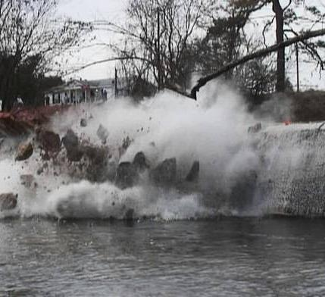
RESTORATION EFFORTS
PEOPLE
(regulations)
FISH
(stocking)
HABITAT
(fish passage,
dam removals)

Slide 16
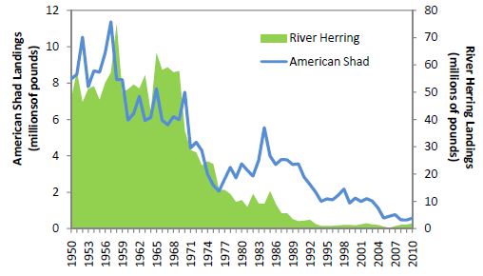
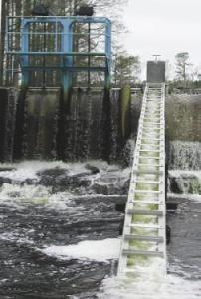
RESTORATION EFFORTS
PEOPLE: Reduce mortality, allow to reproduce
Stricter fishing regulations & closures (moratoriums)
HABITAT: Increase hatching and young survival / growth
Dam removals
Passage structures at dams
Physically transfer upstream (trucks)
Improve land uses & water quality
FISH: Stocking of young
Chemical (OTC) or genetic marking to see if returning

Slide 17
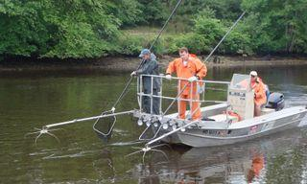
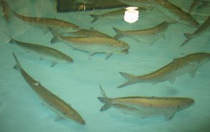
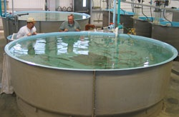
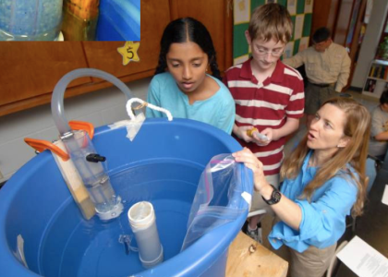
YOUR SHAD EGGS
Collect adults by electrofishing
2. “Natural” spawning
in hatchery tanks
3. Eggs collected & maintained
4. Brought to your classroom

Slide 18
RESEARCH
Chowan River Study:
Planted fertilized eggs in rivers, streams
Determined hatching success

Slide 19
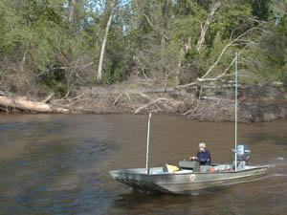
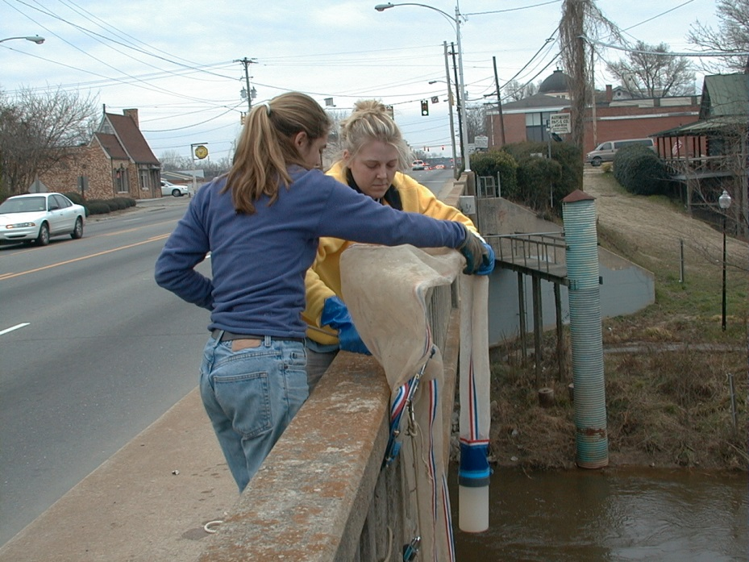
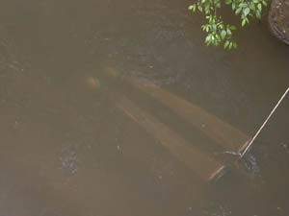
RESEARCH
Neuse River Study:
Examine response to dam removal
Tracked fish with transmitters to study migration
Sampled for shad eggs from bridges

Slide 20
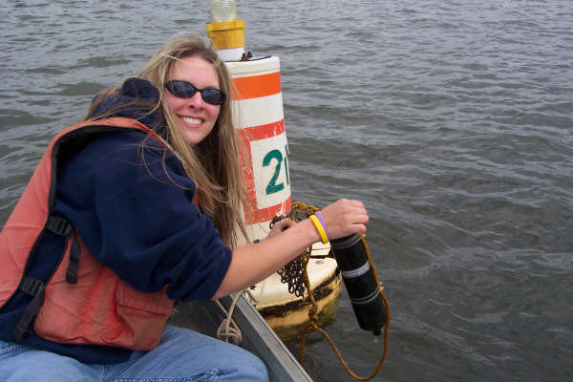
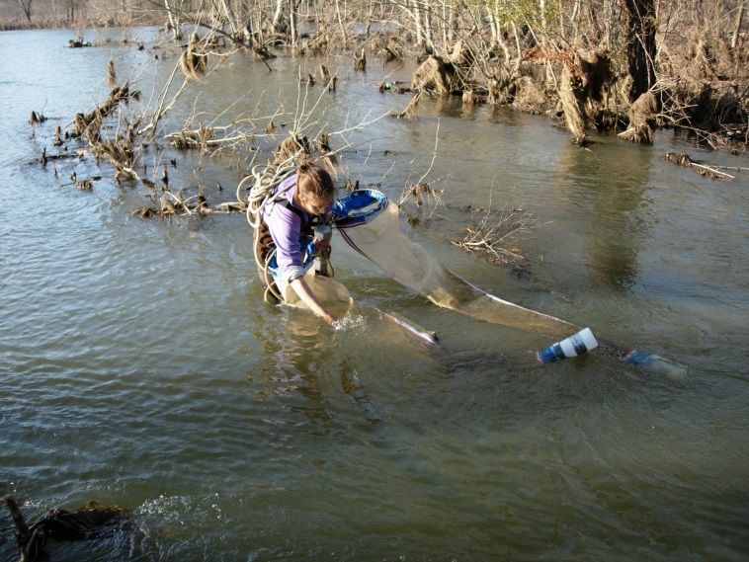
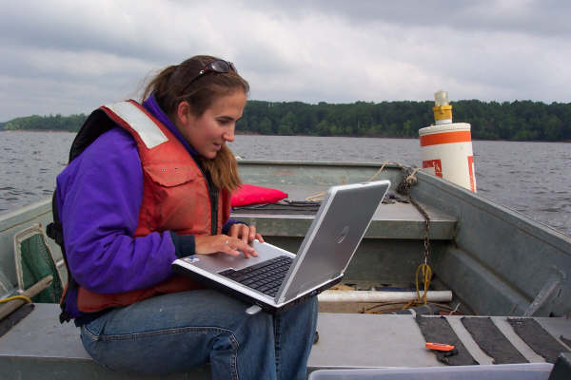
RESEARCH
Roanoke River Study:
Tracked fish with transmitters to study migration
Sampled for eggs to study spawning locations

Slide 21
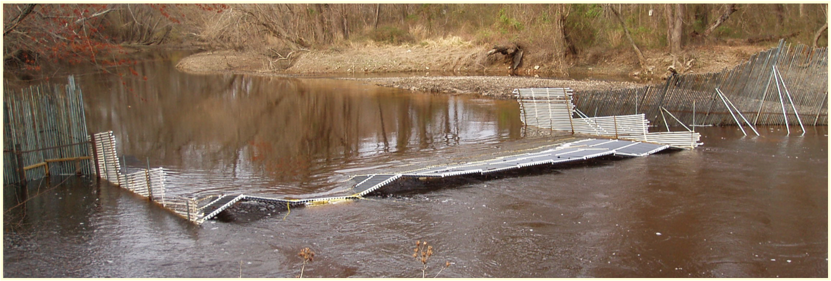
RESEARCH
Little River Study:
Tributary to Neuse River w/ 3 dam removals since 1998
Capture shad near river mouth with a fish weir

Slide 22
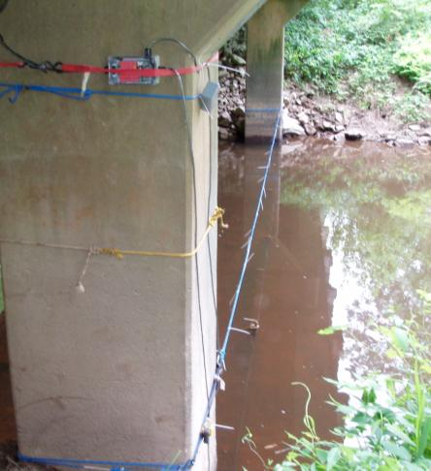
RESEARCH
Little River Study
Receive a PIT tag – identification number
Monitor migrations at PIT antennas throughout river
Results:
Shad utilizing restored upstream habitat
Flow very important in migrations & habitat use

Slide 23
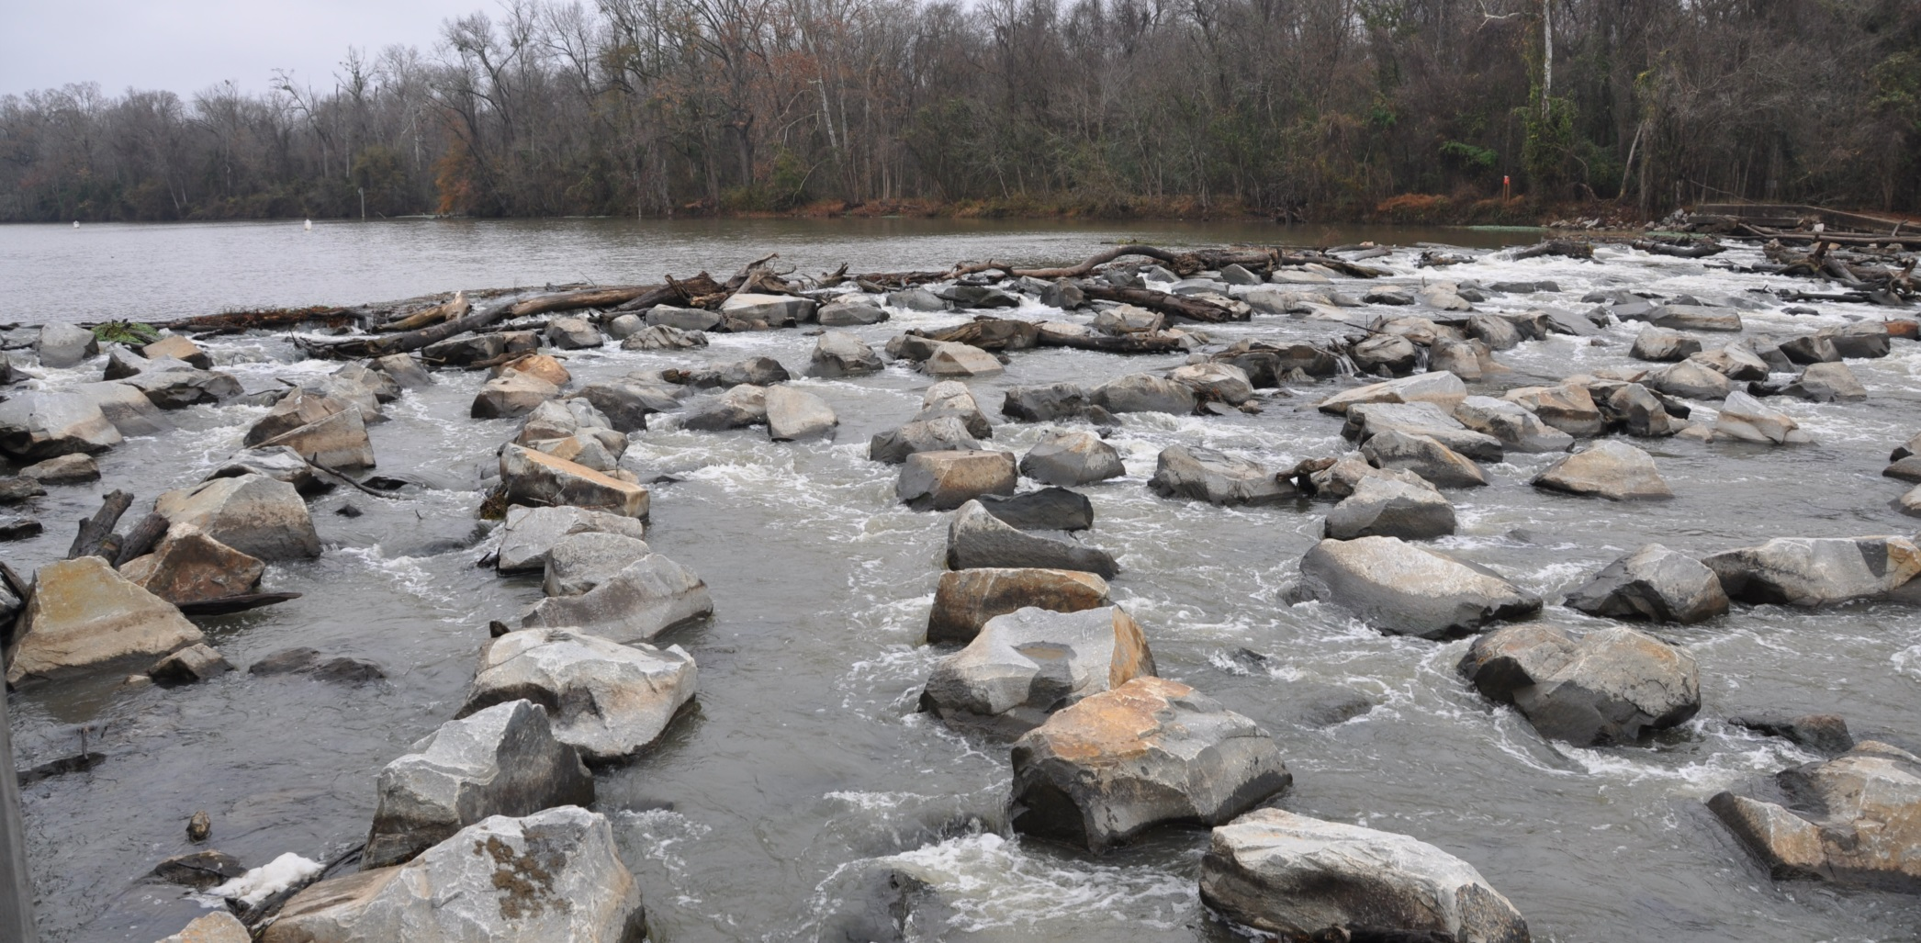
RESEARCH
Cape Fear River Study:
Evaluate passage at rock arch rapids at Lock and Dam 1
Sonic telemetry tags & receivers

Slide 24
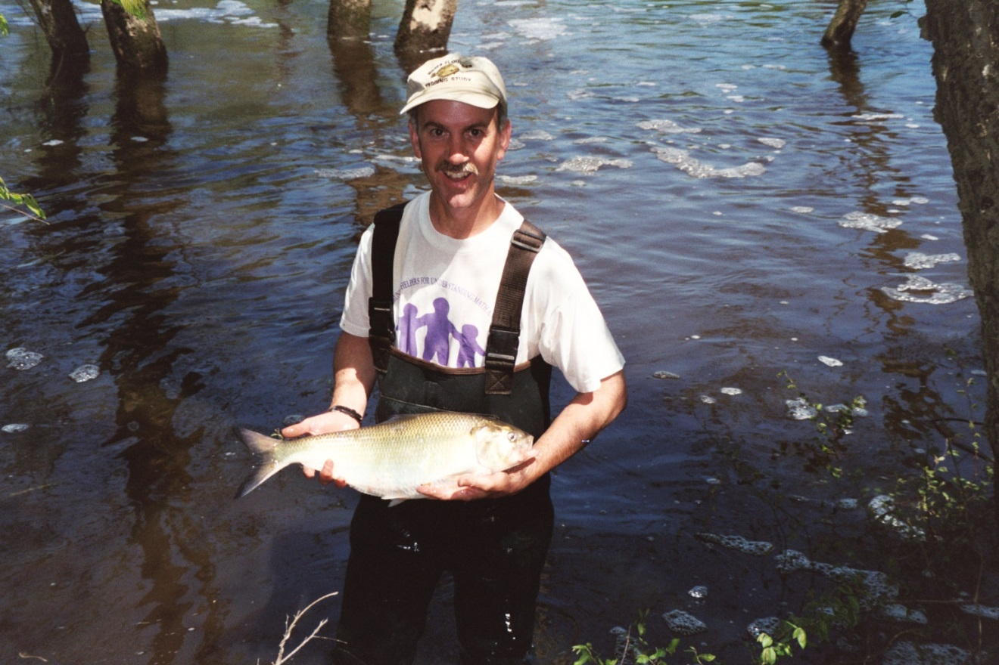
Questions? Contact: jhightower@ncsu.edu

