Slide 1
What is solubility?
Solubility is the ability of a substance to dissolve (become trapped in) another substance.
Temperature can increase solubility.
Example: hot tea vs. iced tea

Slide 2
What is a solution?
A solution is formed when one substance dissolves in another substance. The two substances mix evenly.
The ingredients lose some of their physical properties and they can be difficult to separate.
Solute + Solvent = Solution

Slide 3
What properties do sugar and salt lose when they dissolve in water?

Slide 4
What properties do sugar and salt lose when they dissolve in water?
Color
Texture
Shape
State of matter
…they seem to disappear!

Slide 5
Can you name a property that sugar and salt do NOT lose when they dissolve in water?

Slide 6
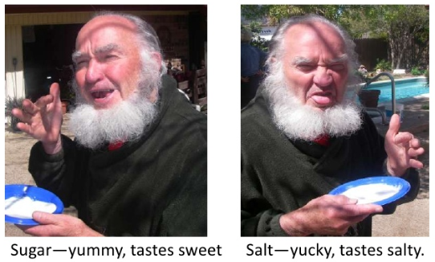
Can you name a property that sugar and salt do NOT lose when they dissolve in water?
We can still taste it!

Slide 7
Did sand lose any of its physical properties when it was mixed with water?

Slide 8
Did sand lose any of its physical properties when it was mixed with water?
Sand DOES NOT lose any of its physical properties when it is mixed with water. The sand is still:
1. A solid
2. A tan color
3. Gritty
4. Easy to separate (pour off water or filter)

Slide 9
If you leave a solution of sugar and water or salt and water out on the counter for several days, what happens?
a. The sugar or salt disappear.
b. The sugar or salt water take on a different taste.
c. The water evaporates and sugar or salt crystals form.
d. The sugar and salt evaporate along with the water.

Slide 10
If you leave a solution of sugar and water or salt and water out on the counter for several days, what happens?
a. The sugar or salt disappear.
b. The sugar or salt water take on a different taste.
c. The water evaporates and sugar or salt crystals form.
d. The sugar and salt evaporate along with the water.

Slide 11
When the water evaporates, only the water changes to a gas (water vapor).
The salt or sugar is left behind as solid crystals.

Slide 12
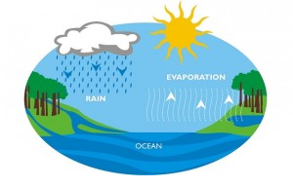
The water cycle helps clean water!!
Animals live in water…they defecate, urinate, die, and decay in the water.
You can imagine the different substances that are dissolved in lake water…but water cleans itself via the water cycle.
When water evaporates, the substances mixed with the water are left behind. The liquid water in clouds and rain droplets is clean, pure water.

Slide 13
What are some other substances that are water soluble (able to dissolve in water)?

Slide 14
What are some other substances that are water soluble (able to dissolve in water)?
Soap
Coffee
Aspirin tablet
Food coloring
Carbon dioxide
Baking soda
Epsom salt
Vinegar
Honey
Oxygen
Lemon juice
Hot chocolate

Slide 15
These are called…the solute.
A solute is the substance that is being dissolved
The substance that is the smaller amount or the substance that experiences a phase change

Slide 16
What are some other substances that are water insoluble (unable to dissolve)?

Slide 17
What are some other substances that are water insoluble (unable to dissolve)?
Oil
Flour
Metal
Plastic
Chalk
Black pepper
Wood
Wax

Slide 18
Water as a solvent
The solvent is the substance doing the dissolving
The substance that is the larger amount
Water is considered the universal solvent because it dissolves more substances than any other liquid. This is important to every living thing on earth!!

Slide 19
Remember…
A solution is formed when one substance dissolves in another substance.
Solute + Solvent = Solution

Slide 20
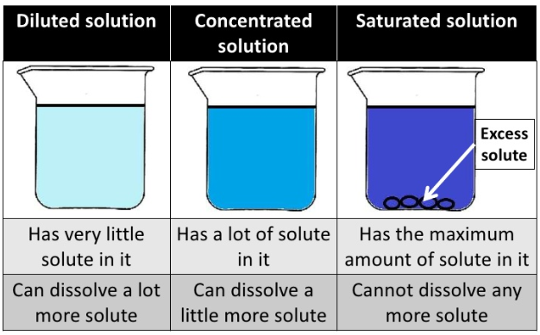
Dilute vs. Concentrated vs. Saturated
A dilute solution has too much solvent.
A saturated solution has too much solute that cannot be dissolved any further.

Slide 21
In Summary…
When certain substances mix with water they dissolve.
When a substance dissolves in water, the resulting liquid is called a solution.
When a substance dissolves in water, that substance loses some of its physical properties.

Slide 22
Matter Weekly Packet
Due Friday, December 6th.

