Slide 1
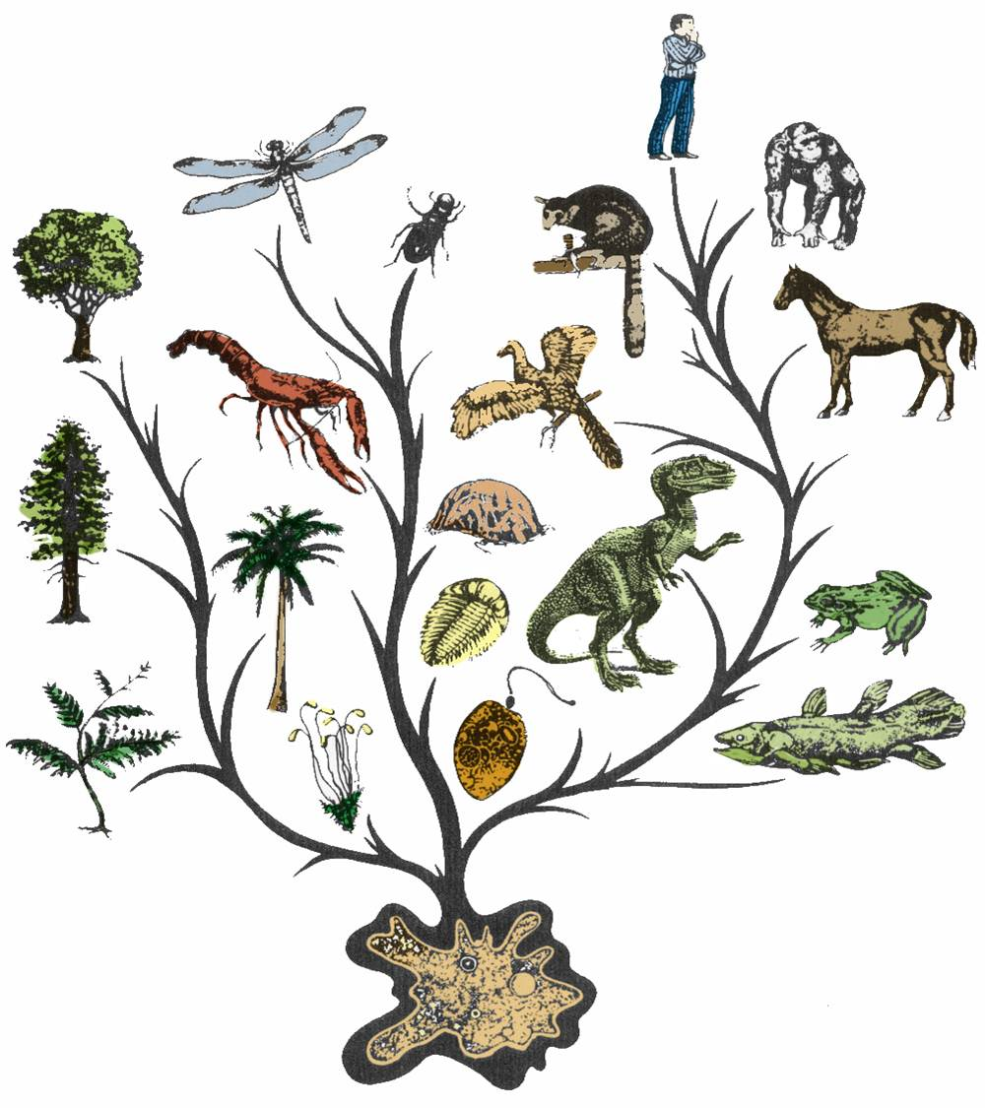
Evolution
“Nothing in Biology makes sense except in the light of evolution” Dobzhansky, 1973

Slide 2
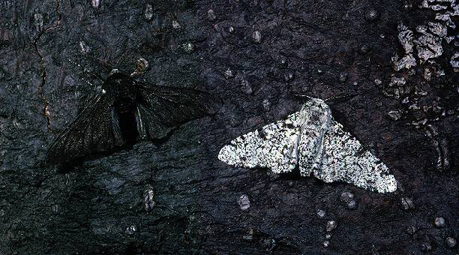
Why are these two moths different?
Notes:
What’s wrong with this story? How would your students react to this story?

Slide 3
What is Evolution
It means that all living things on Earth are probably descended from a common ancestor. Why probably?
The great diversity of organisms is the result of more than 3.5 billion years of evolution that has filled our Earth with life forms.
The millions of different species of plants, animals, and microorganisms that live on earth today are related by descent from common ancestors.
Notes:
#1 is not necessarily true because life could have originated independently several times instead of only once. Even Darwin says this in The Origin of the Species. Include line from conclusion. Everything you’ve ever seen in your life is related to you. #2 not every niche has been filled. For instance, there are niches in regions where marsupials live, but marsupial things haven’t evolved to fill those niches. There are constraints to evolution; it’s not always moving toward progress.

Slide 4
Notes:
Other theories: gravity—they deal with it all the time. The theory of general relativity explains gravity and no one is going to say it’s wrong. There is literally no scientist on the planet who disputes the theory of relativity. Theories have withstood thousands of tests to demonstrate that they’re wrong and they’ve never failed. Nothing has ever contradicted it.

Slide 5
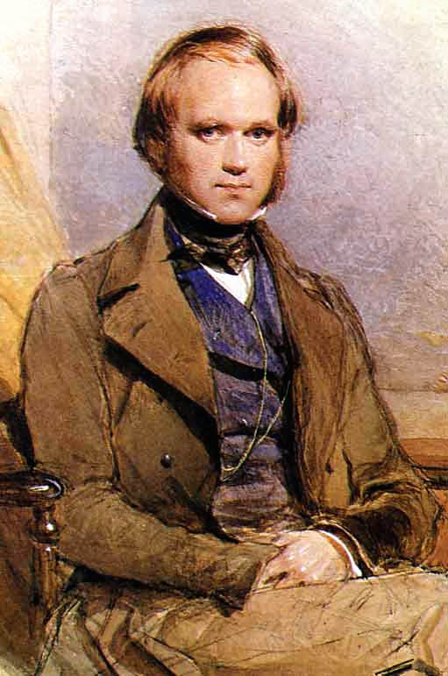
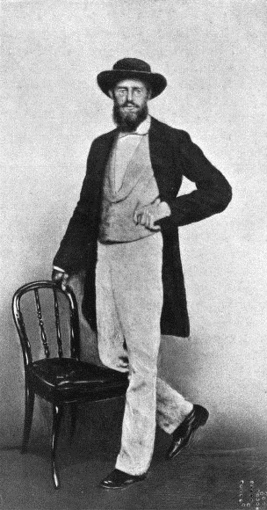
The concepts of common descent and natural selection were first proposed by Charles Darwin in his famous book, The Origin of Species in 1859
Notes:
Put pictures of them as young guys and add in Wallace. The idea that there was common descent had been tossed around for a while. The papers were read at a meeting that neither of them were able to attend. All the copies sold the first day and they had to reprint it immediately. Both were young when they were writing this stuff.

Slide 7
Evidence for Evolution comes from different sources and various disciplines:
Fossils
Biogeography
The Law of Superposition
Artificial Selection
Vestigial Organs: The evolutionary legacy we carry within our own bodies
Similarities: Comparative Anatomy
Overwhelming Genetic Evidence (not available in Darwin’s time)
Notes:
Observable natural selection and evolution in the wild. Use examples. Hendry’s paper 1)Steelhead and rainbow trout—good example of speciation and 2)E. coli, anti-biotic resistant stuff *You can point out that this one on thousands of examples to talk about.

Slide 8
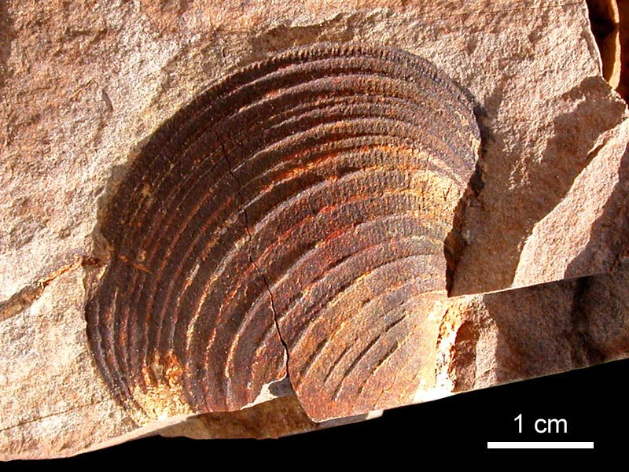
1. Fossils: Traces of long-dead organisms
A fossil mold is formed by the impression left in rock by the remains of an organism.

Slide 9
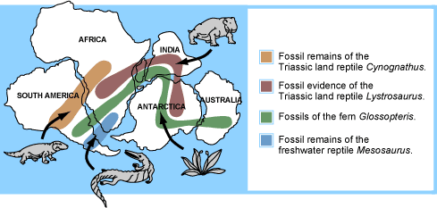
2. Biogeography: the study of the geographical distribution of fossils.
Wallace was very interested in biogeography because he noticed that rivers and mountains often formed boundaries between different species.
Wallace knew that biogeography was related to natural selection.
Wegener’s theory of plate tectonics (1915) helped make sense of Wallace’s findings.
From evolution.Berkeley.edu
Notes:
Maybe mention the Wallace line. Could throw in something about plate tectonics.

Slide 10
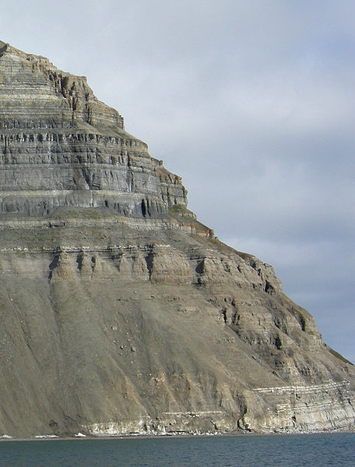
3. The Law of Superposition
Successive layers of rock or soil were deposited on top of one another by wind or water
The lowest layer (stratum) will be the oldest.
Relative age: a given fossil is younger or older than what is below or above it
Absolute age: actual numerical age based on dating of sediment around fossil

Slide 11
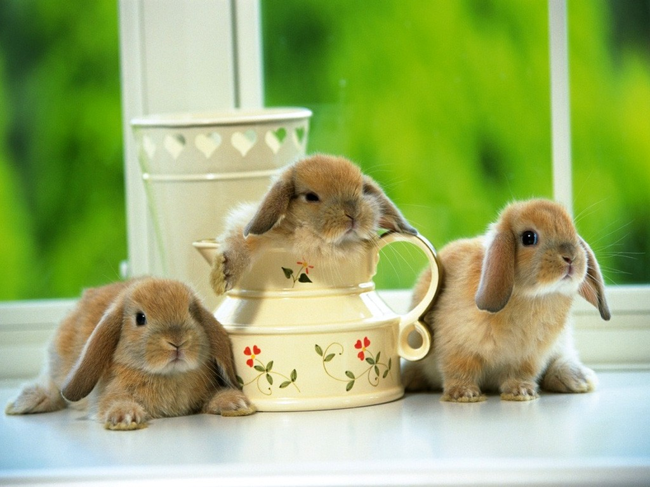
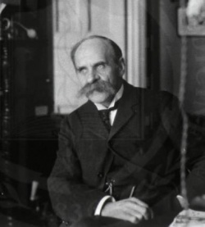
How could you test evolution using the Law of Superposition?
When asked what would make him doubt evolution, the famous biologist, J.B.S. Haldane, answered, “Find me a rabbit fossil in Pre-Cambrian Rock.”
Notes:
Maybe the overarching theme could be “How would you test this?” rather than “What would make you change your mind?” Make this an activity, too—draw a stratigraphic profile that shows evolution isn’t true.

Slide 12
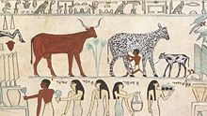
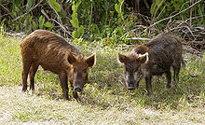
4. Artificial Selection
Darwin noticed how farmers and breeders allowed only the plants and animals with desirable characteristics to reproduce, causing the evolution of farm stock. He used this as evidence in Origin of Species.
Cows being milked in
ancient Egypt
These pics both show the same animal,
feral vs. domestic pigs.
Notes:
Change at the bottom. Put in something about teleology here—what do you think would have happened to the feral pigs if they hadn’t been domesticated? If not for artificial selection, would feral pigs have still developed this way?

Slide 13
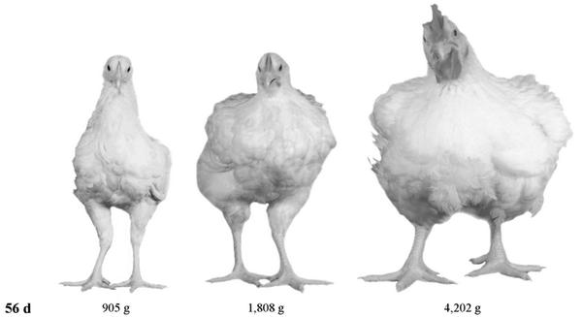
What happened here?
1957
1978
2005
From www.evolution.berkeley.edu
Notes:
A 56 day old chicken in 1957, 1978 and 2005

Slide 14
A Great Example of Artificial Selection
1978
2005
“Artificial selection provides a model that helps us understand natural selection.
It is a small step to envision natural conditions acting selectively on populations
and causing natural changes.”
From www.evolution.berkeley.edu
Notes:
A 56 day old chicken in 1957, 1978 and 2005

Slide 15
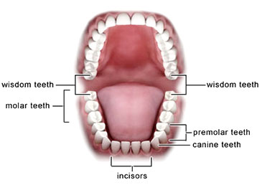
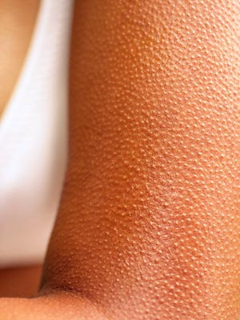
5. VESTIGIAL STRUCTURES are features that were adaptations for an organism’s ancestor but have evolved to no longer perform their original function due to a change in the organism’s environment.
Wisdom teeth
Goose bumps
Goose bumps
C= hind legs on whale skeleton
Notes:
15
Need more background into to be able to explain. Look up recent evolution paper on whale hind legs. Appendix—what did it do originally? If evolution was directed at making us better, why would we still need something that caused us problems?

Slide 16
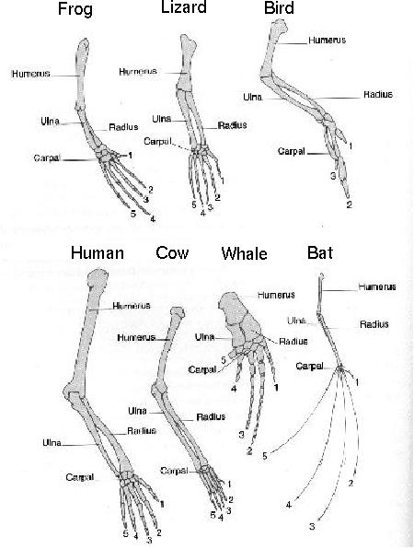
6. Similarities among related organisms:
Homologous structures:
Comparative Anatomy: The study of Homologous traits (ex. forearms) features in different species that are similar because those species share a common ancestor.

Slide 17
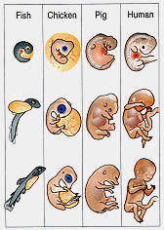
Embryonic development is also strikingly similar among related organisms.
Comparative Embryology:
Notes:
How do you think you breathed when you were inside your mom?

Slide 18
7. The latest overwhelming evidence for evolution comes from molecular biology
Molecular Biology: is the strongest evidence for evolution. Not even known in Darwin’s time, it involves comparing the DNA of different species to determine their relatedness.
Just like our forelimbs or embryos are similar, so are our genes.
Genes are also homologous structures.

Slide 19
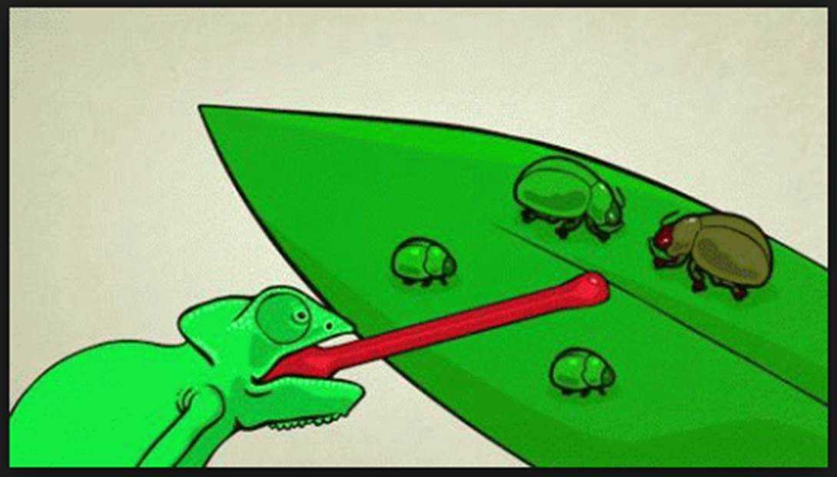
WHY and HOW do things evolve?
The best explanation for why and how living things change over time is natural selection in a population.
http://www.musingsone.com/2015/11/why-are-we-still-searching-for-evidence.html

Slide 20
How does natural selection work?
Species evolve over time.
Natural Selection will occur if:
Individuals in a population (group of organisms of the same species) have genetic differences; they show variability.
Not all of the individuals reproduce, but the reproduction is not random.
The individuals with an advantageous trait will increase their chances of reproduction.
These advantageous traits are passed on to their offspring.
Notes:
Title should be 5 principles of Evolution by natural selection. What if we’re the ancestral chickens with different mutations? Who will survive and why? What if the environment changes?

Slide 21
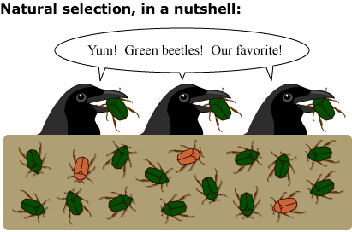
Natural Selection is one of the primary mechanisms leading to change over time in organisms. It is a driving force behind evolution along with genetic drift, gene flow and mutations.
Psst…
Or, maybe it’s just that those
green beetles are easier
to find!!! Yummy!
Notes:
It’s a very important driving force, but there’s also drift, gene flow, mutations, etc.

Slide 22
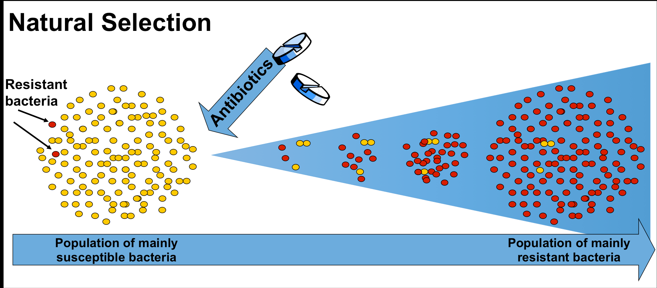
How does natural selection play a role in our own lives? Ex: Antibiotic resistance
http://www.reactgroup.org/toolbox/category/understand/the-rise-and-spread-of-antibiotic-resistance/
Notes:
Why is the orange one orange? How did it know it needed to be orange before antibiotics were even around? See if I can find more images of antibiotic resistance.

