Slide 1
What is Ecology?
Notes:
1

Slide 2
Origin of the word…”ecology”
Greek origin
OIKOS = household
LOGOS = study of…
Study of the “house/environment” in which we live.
Notes:
2

Slide 3
ECOLOGY: Levels of Organization
- a hierarchy of organization
in the environment
Notes:
3

Slide 4
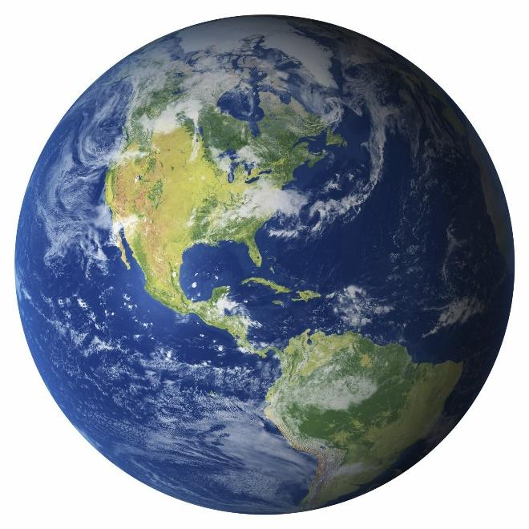
Levels of organization - Terms
Biosphere
Surface of the earth
Composed of many ecosystems
Ecosystem
An interactive systems that include both biological communities and physical components of the environment
Notes:
4

Slide 5
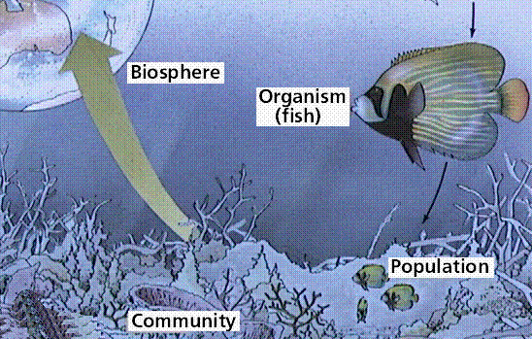
Levels of organization - Terms
Community – Different populations that live in a particular area
Population – a group or organisms belonging to the same species that live in a particular area
Notes:
5

Slide 6
Levels of organization - Terms
Habitat – Where an organism lives
Organism – simplest level of organization
Notes:
6

Slide 7
Very complex
Can contain 100’s to 1000’s of interacting species.
Notes:
7

Slide 8
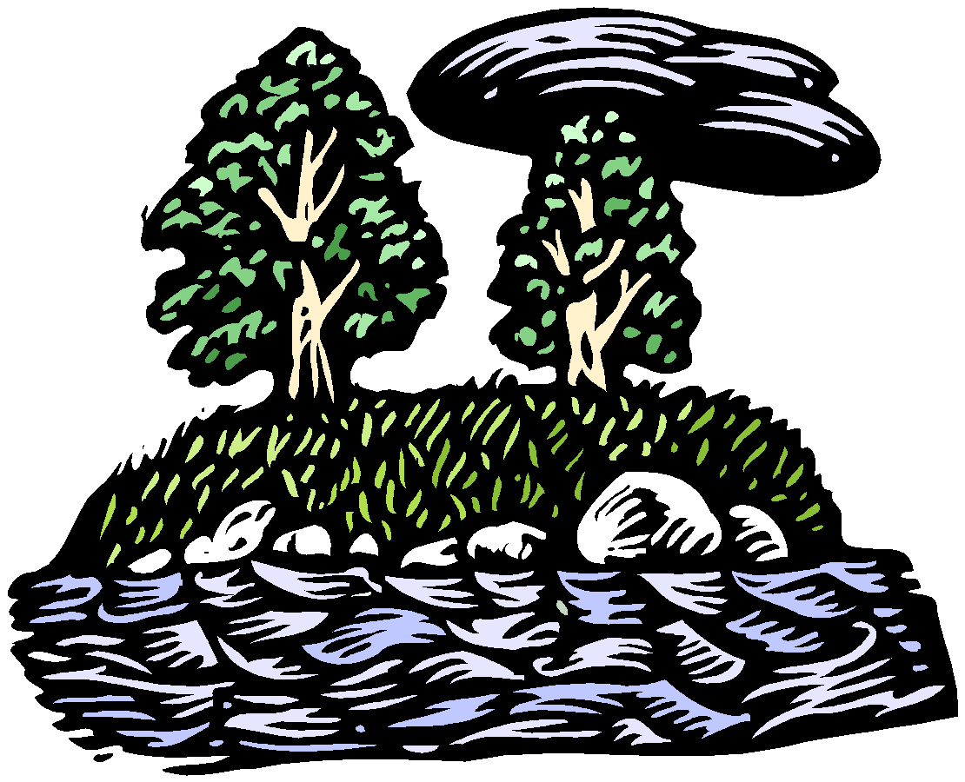
Ecology is study of interactions between
non-living components in the environment…
light
water
wind
nutrients in soil
heat
solar radiation
atmosphere, etc.
AND…
Notes:
8

Slide 9
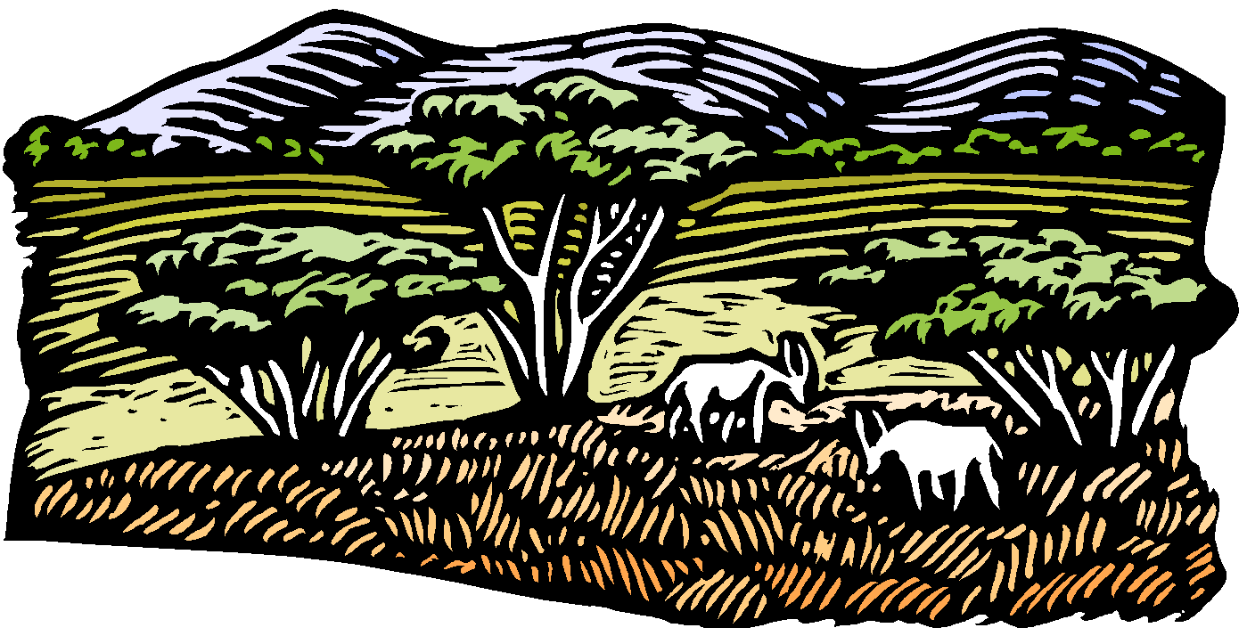
Living organisms…
Plants
Animals
microorganisms in soil, etc.
Notes:
9

Slide 10
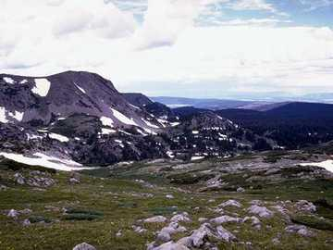
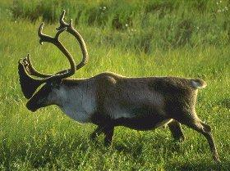
Ecology…
views each locale as an integrated whole of interdependent parts that function as a unit.
caribou
tundra
Notes:
10

Slide 11
The interdependent parts are…
Notes:
11

Slide 12
Nonliving
dead organic matter
nutrients in the soil and water.
Producers
green plants
Tundra
Notes:
12

Slide 13
Consumers
herbivores and carnivores
Decomposers
fungi and bacteria
Tundra
Caribou
Notes:
13

Slide 14
Therefore…
Ecology is an integrated and dynamic study of the environment.
Notes:
14

